Slide 1
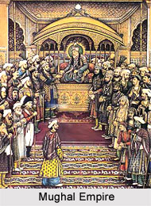
Decline of the Mughals (1707-1857)

Slide 2
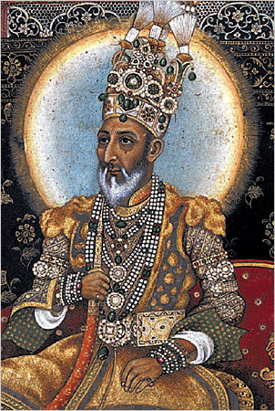
Role of Aurangzeb in the Decline
Religious policy
Aurangzeb was brave and untiring in carrying out his duties, but he failed to be a good ruler because of his religious orthodoxy.
In 1679, he re-imposed the Jizia on the non-believers.
He denounced the idea of joining hands with the Hindus for the integrity of the Empire.
He ordered demolition of several hundred temples.
His religious policies insulted the non-Muslims and caused discontent and unrest.
Rajput policy
Aurangzeb did not attach enough importance to the Rajput alliance.
In December 1678, he introduced a change of policy towards the Rajputs who had contributed much to the growth of the Mughal Empire in India.
When he annexed Marwar, Aurangzeb's aggressive policy drove the Rajputs to gather forces and the Rajput War turned into almost a national uprising.

Slide 3
Rise of the Marathas
The Maratha rise began during Aurangzeb’s rule under their brilliant leader Shivaji, who united people of all castes under a common Maratha identity.
By 1691, the Marathas (under the Peshwas) had become strong enough to rise up in rebellion under Raja Ram, one of Shivaji’s sons and other Maratha chiefs.
The Marathas waged guerilla warfare and were never completely subdued by Aurangzeb, even after 20 years of fighting. They ravaged the countryside and went as far as Mysore in the south, Bengal in the east and Delhi in the north.
The Maratha conquests accelerated the disintegration of the Empire.

Slide 4
Economic Decline
The land revenue taxes increased from the time of Akbar, and kept increasing under successive emperors. More than half of the produce was taken as tax. People's miseries increased after Aurangzeb's death and peasants often left their lands in despair.
The discontent of the peasants was a major reason for the uprisings by the Jats and the Sikhs.
Many peasants formed bands of robbers and adventurers(thuggee) weakening law and order further.
Local Mughal nobles and governors often disrupted trade by holding businessmen for ransom, imposing arbitrary taxes and forcing them to give loans which were never returned. This weakened trade and commerce and shifted the loyalty of the Indian merchants towards European powers.
The Mughal court since Akbar’s time used most of the revenue for consumption and luxuries, there was no investment in agriculture or irrigation to improve productivity.
With decline in revenues, the Mughal army and nobles were often paid in arrears, this made them mutinous.
Aurangzeb’s long Deccan campaign also drained the treasury and disrupted trade.

Slide 5
Wars of Succession
After the death of Aurangazeb, a war of succession broke out among his three sons, Muazzam (Governor of Kabul), Muhammad Azam (Governor of Gujrat) and Muhammad Kam Baksh (Governor of Bijapur).
In his will, Aurangazeb had directed his sons to divide the Empire peacefully among them. But at his death, there arose a bitter struggle for the throne of Delhi.
Muazzem (title:Shah Alam I) became the sole ruler by defeating and killing his brothers, but when he died in February 1712, a fresh war of succession broke out among his four sons.
Jahandar Shah, became the emperor by defeating and killing his brothers. However, he was deposed by Farrukhsiyar, a son of one of the defeated princes.
Such conflicts arising out of battles for succession, weakened the Mughal Empire and robbed it of the authority it had hitherto enjoyed.

Slide 6
Rise of Regional Powers
Mughal governors and princes established autonomous kingdoms throughout the empire – Oudh, Bengal, Hyderabad, and so on. It was said in the reign of Shah Alam, his influence only extended from ‘Delhi to Palam’ (where the present international airport is located).
The Mughal Emperors became dependent on the regional powers for money and became a pawn in their hands. By 1760, the Emperor was a hostage in the hands of the Marathas.

Slide 7
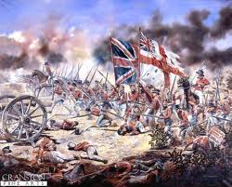
Role of the European Powers
The Mughals neglected the navy and this proved to be a disaster. The coastline was left unprotected and the Europeans were able to establish themselves in India with little difficulty.
Various European nations who had established trade relations with India, seeing the weakness of the Mughal Empire, began to focus more on political influence than trade in India.
Through diplomacy, military skill and persistence, the English East India Company emerged as successful in exploiting the volatile circumstances in India in general and Bengal in particular.
The arrival of the British was to prove fatal to the Mughal Empire. Britain was the most technologically advanced country in the world and the British brought with them weapons far in advance of those used by the Mughals.
The British also brought a unity and sense of determination which the divided Mughals lacked.

Slide 8
Lessons for Today
Good governance and administration is important to hold a country together
Taxation systems should be fair and equitable and incentivize people to be more productive
Handling the economy to make it more efficient to increase the revenues of the country is very important
Administration should be efficient and control costs.
Negotiations and understanding and not coercion(force) should be used to win over disaffected groups.
It is important to be fair to all religious and ethnic groups. A ruler should treat all his/her countrymen in the same manner, regardless of religion, caste or creed.
Defence and security needs should change with the times and it is important to keep pace with modernisation. (the British came by the sea and had efficient guns and artillery)

Slide 9
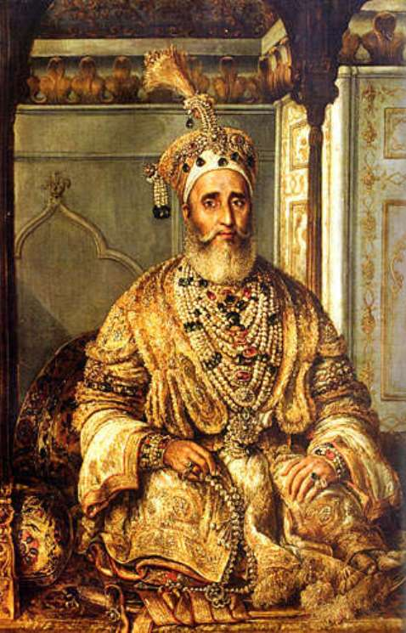
Bibliography
http://projects.cie.org.uk/banglao/textbook/historyandculture/mughal/SectionB
http://library.thinkquest.org/C006203/cgi-bin/stories.cgi?article=decline&section=history/mughals&frame=parent
The Last Mughal – Bahadur Shah Jafar- deposed in 1857 after the First War of Independence.

