Slide 1
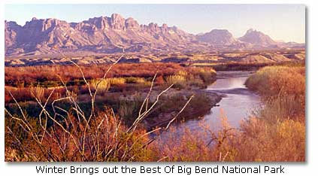
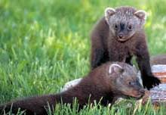
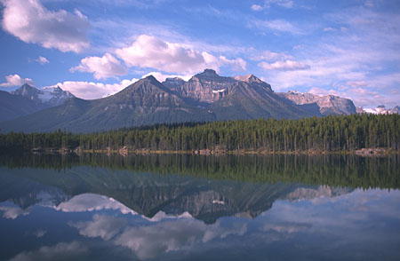
WHAT ARE ECOSYSTEMS?

Slide 2
Where Things Live
Living things need a place to live and grow.

Slide 3
Fish live in water.

Slide 4
Birds live in trees and fly through the air.

Slide 5
Plants grow where there is soil, water and sun.

Slide 6
Main Idea and Details
Living things need
a place to live
and grow.
Fish live in water.
Birds live in trees
and fly in the air.
Plants grow where
there is soil, water
and sun.

Slide 7
ENVIRONMENT
The living and nonliving things that surround a living thing make up its environment.

Slide 8
What do living things get from their environments?
Many living things share their environments and its resources.
Food
Water
Oxygen
Space

Slide 9
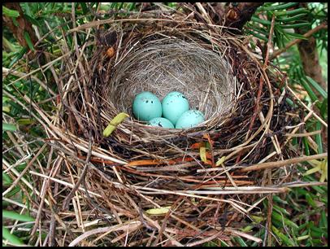
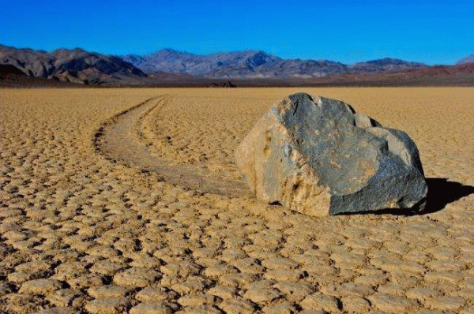
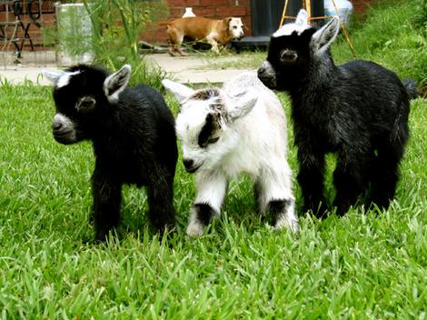
Parts of an Ecosystem
An ecosystem is made up of all the living and nonliving things in an environment.

