Slide 1
Forest Ecosystems
Forest are ecosystems in which many trees grow.

Slide 2
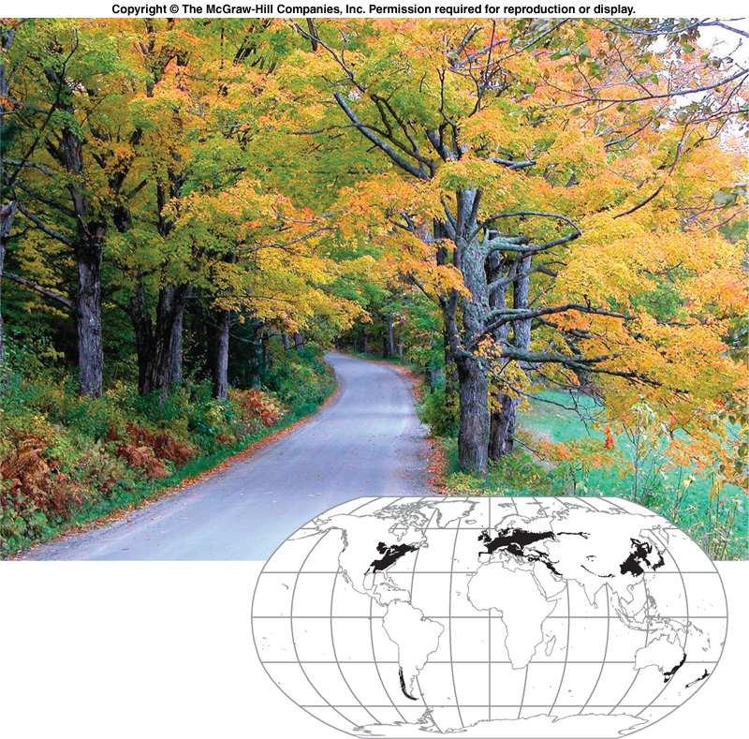
Temperate Deciduous Forest

Slide 3
Deciduous Forest
What's A Temperate Deciduous Forest Like?
One of the most interesting features of the temperate deciduous forest is its changing seasons.
The word "deciduous" means exactly what the leaves on these trees do: change color in autumn, fall off in the winter, and grow back again in the spring. This adaptation helps trees in the forest survive winter.

Slide 4
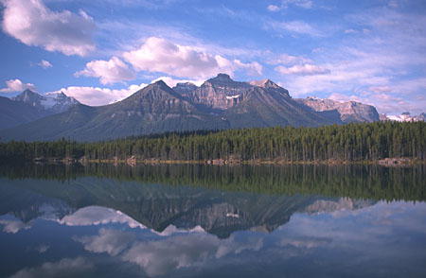
Tropical Rain Forest
A tropical rain forest grows where it is hot and wet all year long.
Animals such as jaguars and monkeys live there.

Slide 5
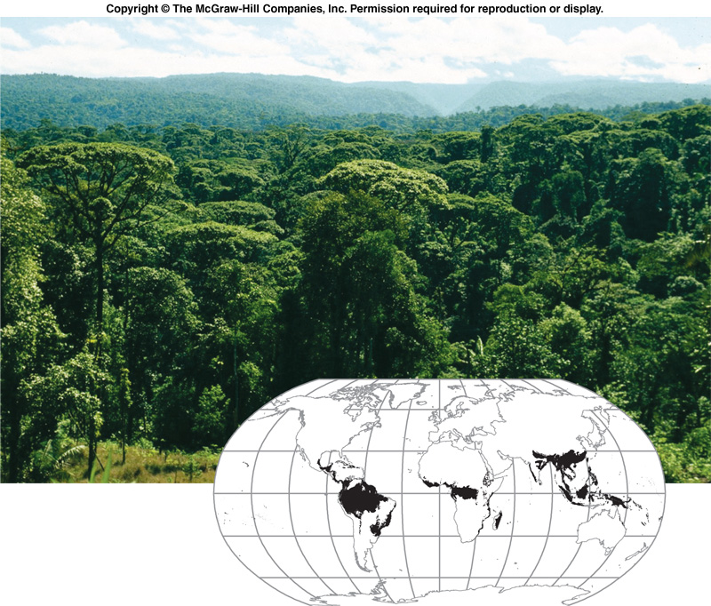
Tropical Rainforest

Slide 6
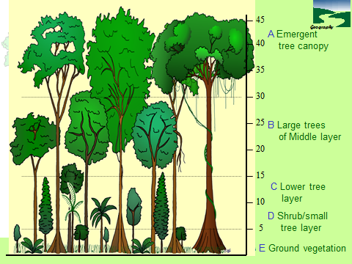

Slide 7
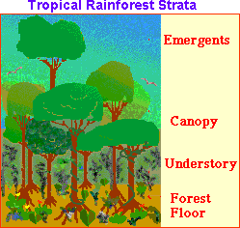
Layers of the Rainforest
Different animals and plants live in different parts of the rainforest. Scientists divide the rainforest into strata (layers) based on the living environment. Starting at the top, the strata are:
  EMERGENTS: Giant trees that are much higher than the average canopy height. It houses many birds and insects.
  CANOPY: The upper parts of the trees. This leafy environment is full of life in a tropical rainforest and includes: insects, birds, reptiles, mammals, and more.
  UNDERSTORY: A dark, cool environment under the leaves but over the ground.
  FOREST FLOOR: Teeming with animal life, especially insects. The largest animals in the rainforest generally live here.

Slide 8

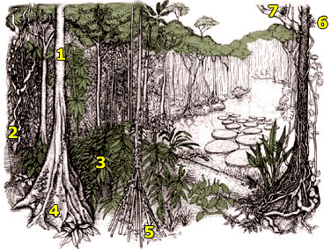
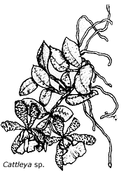
1. Bark
In drier, temperate deciduous forests a thick bark helps to limit moisture evaporation from the tree's trunk.
Plant Adaptations
2. Lianas
Lianas are climbing woody vines that drape rainforest trees. They have adapted to life in the rainforest by having their roots in the ground and climbing high into the tree canopy to reach available sunlight.
6. Epiphytes
Epiphytes are plants that live on the surface of other plants, especially the trunk and branches. They grow on trees to take advantage of the sunlight in the canopy
3. Drip Tips
The leaves of forest trees have adapted to cope with exceptionally high rainfall. Many tropical rainforest leaves have a drip tip. It is thought that these drip tips enable rain drops to run off quickly. Plants need to shed water to avoid growth of fungus and bacteria in the warm, wet tropical rainforest
7. The trees don’t waste time growing branches as they could use this energy to grow faster and reach the sunlight first!
4. Buttresses
Many large trees have massive ridges near the base that can rise 30 feet high before blending into the trunk. Why do they form? Buttress roots provide extra stability,

Slide 9
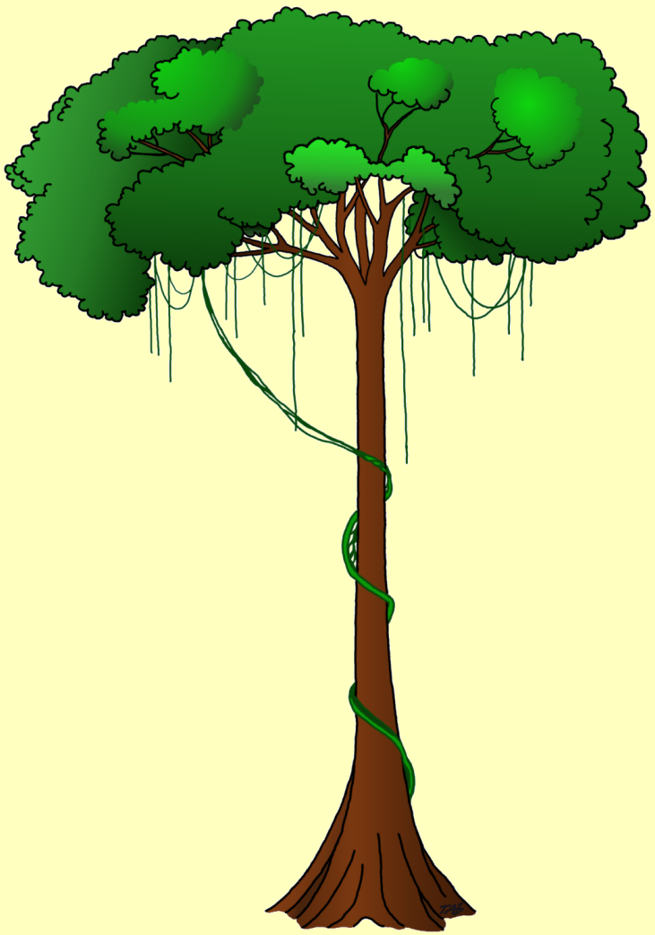
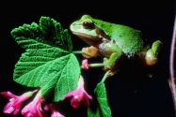
Strong scent of fruits attracts
animals, which feed on the
fruit and assist in dispersal
of the seeds
Strong scent and bright
colours of flowers
attract insects which
assist in pollination
Thick, waxy surface of
leaves protects against
hot sun, heavy rain,
and strong winds
Aerial roots of
epiphytes absorb
moisture from the
air
Tall straight trunks
no side branches
Thin, smooth bark
Shallow spreading
root system
Buttress roots

Slide 10
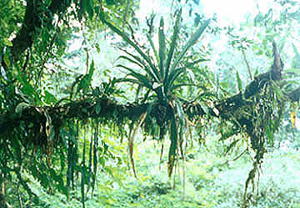
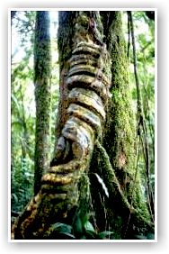
Rainforest plants
And the enormous the number of different species of plants grow in
rainforests, with many species occurring only in one particular region.
Unlike other forests, rain forests have an abundance of :
Epiphytes plants which live above the ground growing on
tree trunks and branches, Example orchids,
ferns, mosses
Climbing plants including large woody climbers called lianas
which are rooted in the soil and usually reach the
canopy. The climbers twist around the tree trunks,
and loop from one tree to another in the canopy,
binding the trees together.

