Slide 1
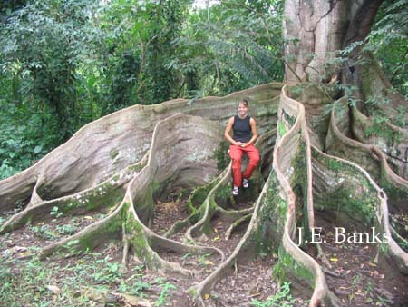
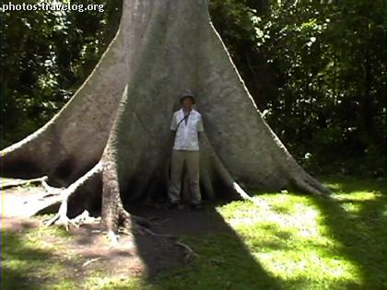
buttress roots
Wide roots stop these enormously tall trees from falling over. They also wind above the ground looking for food and nutrients rather than digging beneath the ground where nutrients are scarce.

Slide 2
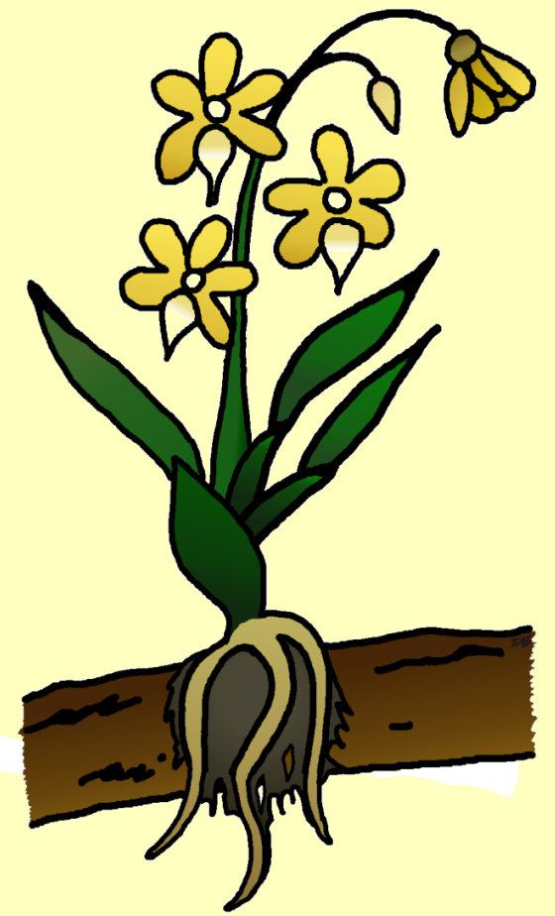
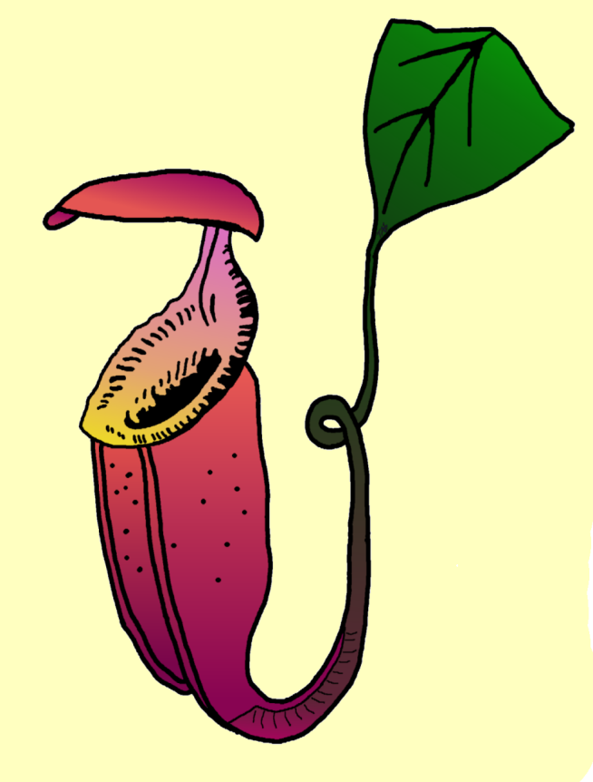
Parasitic plant
Pitcher plant - a carnivorous plant.
slippery rim
tendril
Insects falling into the
pitcher are digested, and nutrients which are released are absorbed by the plant.
Orchid - sun-loving roots
attached themselves to
branches and absorb nutrients

Slide 3
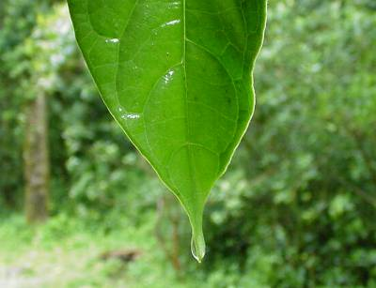
drip tips
These specially designed leaves allow all the rainwater to drip off the leaf quickly so it doesn’t get too heavy and break!

Slide 4
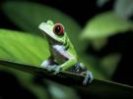
Animals that Live in Rainforests:
Ridiculously huge numbers of animals live in rainforests, including microscopic animals, invertebrates (like insects and worms), fish, reptiles, amphibians, birds, and mammals. The different rainforests of the world support different populations of animals. A few animals from each rainforest are listed below:
South America -
insects (morpho butterfly, Julia butterfly, Monarch butterfly, and millions of other insects)
mammals (jaguar, ocelot, didelphid opossums, sloth, howler monkey, spider monkey, capybara, many bats, marmosets, procyonids, peccaries)
birds (quetzal, macaw, tinamous, curassows, hoatzins, hummingbirds, eagles, ovenbirds, antbirds, flycatchers, puffbirds, toucans, jacamars, tanagers, tapirs, troupials, honeycreepers, cardinal grosbeaks, xenops)
reptiles (anaconda, caiman, iguanas, lizards, microteiid lizards, boas, and coral snakes), amphibians (poison arrow frog, etc.)
fish (electric eel, piranha), and millions of other animals.

Slide 5
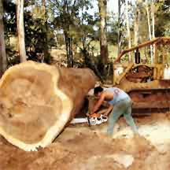
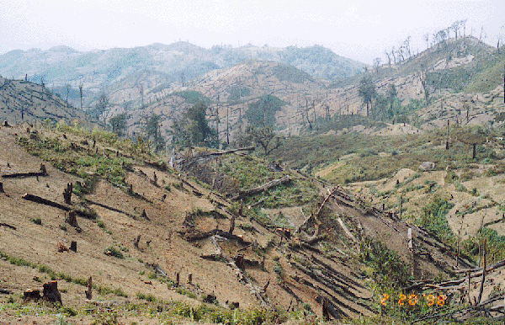
The trees are being cut down at an alarming rate!
DEFORSTATION

Slide 6
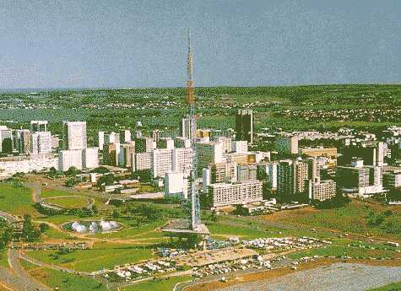
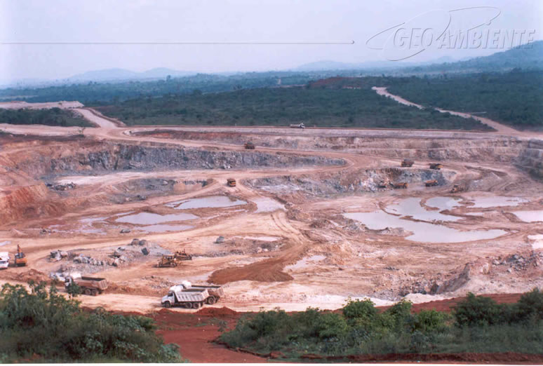
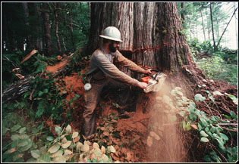
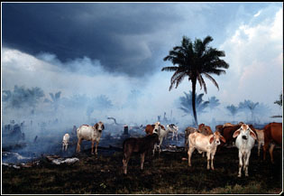
So why are the trees being removed…………………
Settlements
Mining
Timber
Cattle Ranching

Slide 7
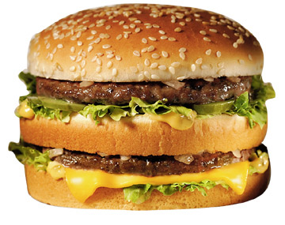
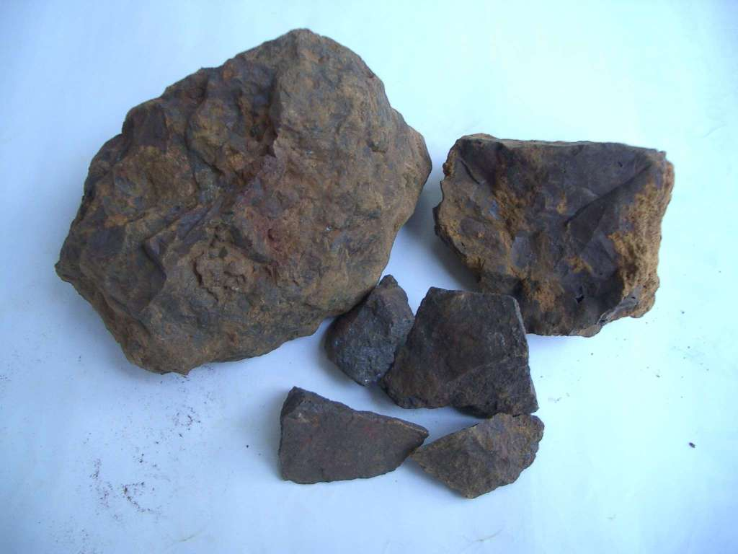
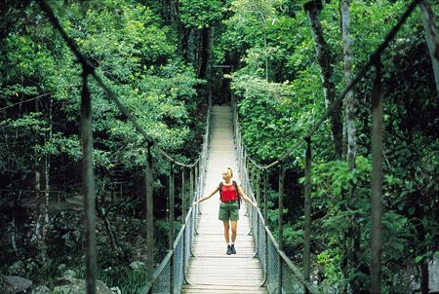
So what does it mean for us?
Yummy McDonalds!
Iron Ore to make steel
Luxurious furntiture
Exciting holidays!

Slide 8
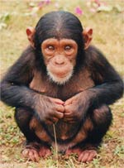
But it’s not all good news!
Trees release oxygen which we need to breath!
Medicines from the rainforest will be lost!
Burning the trees adds to global warming!
And what about the poor old animals?

Slide 9
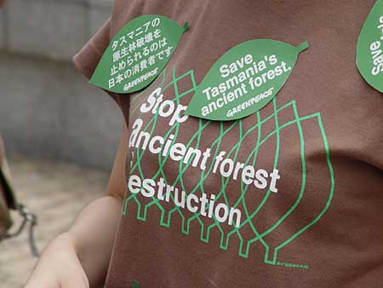
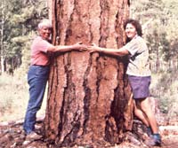
SAVE OUR TREES?

Slide 10
Drawing Conclusions
Suppose all the plants in one ecosystem died.
What do you think would happen to that ecosystem?
Why?
How do plants adapt in a rain forest and in deserts?

Slide 11
Review
Ecosystem What I look like
Desert
Hot and dry
Rains every day and has many trees and plants
Rain Forest
Deciduous Forest
Enough rain for trees to grow. They lose their leaves in the fall.
Freshwater Ecosystems
Made up of rivers, ponds, lakes and streams and my water does not have much salt

Slide 12
Try this!
Choose an ecosystem.
Make a drawing of it.
Write a descriptive paragraph about it.
Include the following details:
Name of the ecosystem
Type of ecosystem: Characteristics
Animals and plants found their.

