Slide 1
English East India Company
Gr.8

Slide 2
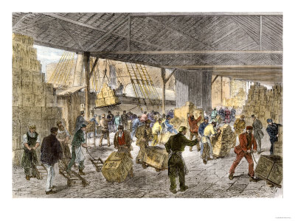
Why were the English successful?
Government policies in England at that time.
A well-trained army.
Internal politics of existing independent kingdoms

Slide 3
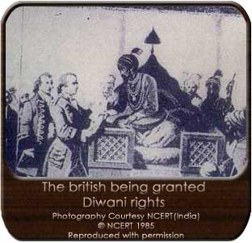
CONQUEST OF BENGAL
Bengal was the first province to be occupied by the English in 1764.
The non- payment of custom duties led to a clash.
Subsequently, two battles were fought – the Battle of Plassey (1757) and the Battle of Buxar (1764)
The defeated Mughal king had to grant ‘Diwani Rights’ to the British – collect revenues from Bengal, Bihar and Orissa. (the first step towards direct administration)

Slide 4
Means of Expansion

Slide 5
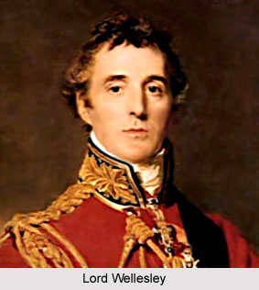
Subsidiary Alliance
Devised by Governor General Lord Wellesley
Any Indian ruler, whose security was threatened, was encouraged to seek help from and enter into an alliance with the English.
The English promised to protect the ruler from external attacks and internal revolts.
The conditions were: British troops would be permanently placed in the territory of the subsidiary state; the ruler would have to pay for the maintenance of the troops; he could not form an alliance with any other power without the permission of the English.
Mysore, Hyderabad, Awadh, the Rajputs and Marathas – forced to accept this alliance

Slide 6
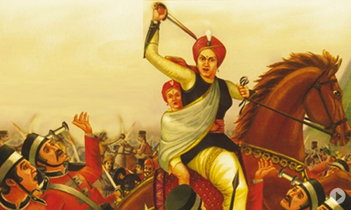
Doctrine of Lapse
Introduced by Governor General Lord Dalhousie.
If the ruler did not have any biological heir to the throne, then the kingdom would ‘lapse’ into the hands of the British.
Satara, Nagpur and Jhansi were annexed under this policy.
Rani Lakshmibai of Jhansi

Slide 7
Direct Annexation
Annex means ‘attach’ or ‘incorporate’.
The British annexed places on the grounds of mis- governance or maladministration.
Surat and Tanjore were annexed and their rulers were pensioned off.

Slide 8
Other Factors which favoured the British
Disunity among the Indian rulers. They fell prey to their policy of ‘divide and rule’.
Being a strong industrial power, Britain used India as a market for their factory-made goods, thus destroying the traditional Indian economy.
The division of society into castes and sub castes failed to unite Indians against a common enemy.

Slide 9
Dual Government
To solve the problem of tax collection, the EEIC carried on administration with the Nawab’s (Shah Alam) officials – two rulers in the same administration.
Administration – in the hands of the Nawab
Revenue – controlled by the Company (no responsibility for organising welfare measures)

Slide 10
1770 – severe famine. Company took no responsibility.
Company officials made money through illegal trade – resulted in reduced profits.
The company had to depend on the British government for loans in order to survive.
Thus the government got an opportunity to control the activities of the Company in India.

