Slide 1
THE FRENCH REVOLUTION
Grade 8

Slide 2
Meaning of the term ‘REVOLUTION’
The word ‘revolution’ describes a time of dramatic and sudden change in history.
The word is also used to describe changes in other aspects such as transport, agriculture and industry which take place over many years.

Slide 3
Introduction
Between 1789 and 1794 a revolution took place in France and the ideas of the revolution spread to other countries in Europe.
To understand how and why the French Revolution occurred, we need to understand the French society of that time.
It was made up of autocratic (absolute), extravagant rulers, privileged nobles and clergy, landless peasants, jobless workers and unequal taxation.

Slide 4
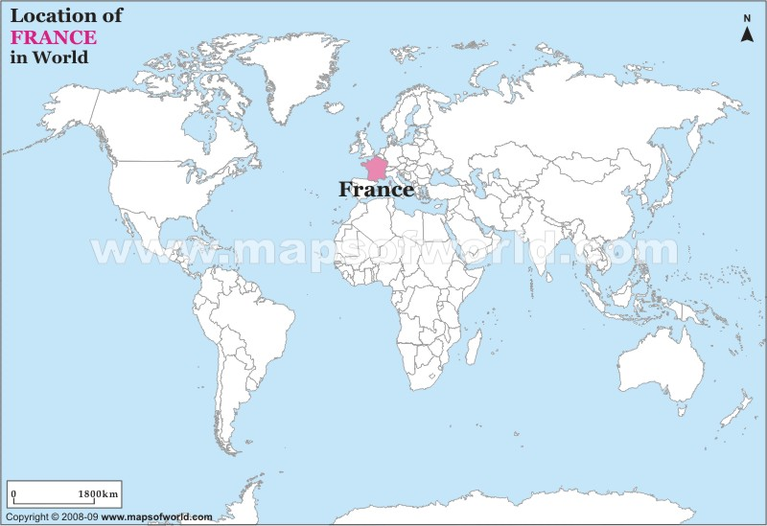
Where in the world is France?

Slide 6
The French Society
The French society was divided into classes or estates.
There were two privileged classes – the clergy and the nobility
They were known as the First Estate and the Second Estate
Their lives were characterized by extravagance and luxury.

Slide 7
The First and Second Estates
The First Estate
The Second Estate
Consisted of the clergy (about 130,000)
They were often the only educated people (besides the nobility)
They held a lot of political and religious power.
They owned over 10% of the land
They were exempt from paying taxes.
They were nobles who inherited their positions and titles.
They were loyal to the monarchy and were let off most taxes.
They owned and managed over one- third of all the land in France.
They exercised their power as landlords.
They got special treatment in the law courts.

Slide 8
The Third Estate
The rest of the people of France were called the Third Estate.
They were common people and made up about 95% of the total population.
They were the underprivileged people, who were part of three different sections.
However, there were many differences in their wealth and style of living

Slide 9
The Bourgeoisie (Middle class) bour·geoi·sie
This class consisted of the educated people- writers, doctors, lawyers, teachers and the richer people who were merchants, bankers and manufacturers.
Economically, this class was the most important one.
However, they had no political rights, social status and its members had to suffer many humiliations.

Slide 10
Artisans and City workers
They were looked upon as inferior creatures without any rights.
They toiled for long hours and paid heavy taxes.
No worker could leave his job for another without the employer’s consent.
Paris had more than 500,000 of them.
This group was to become the mainstay of the French Revolution.

Slide 11
The Peasants
The largest section of the Third Estate consisted of the peasants. (almost 80% of the population)
A large majority were landless or had very small holdings.
They could earn hardly enough for subsistence.
The burden of taxation was unbearable.
They had to pay taxes for local roads and bridges.
A bad harvest under these conditions led to starvation and unrest.

Slide 12
Bad Harvest
Most people in France depended heavily on agriculture and farming in the 1700s.
In the years 1787 – 1789, terrible weather, heavy rain, hard winters and too hot summers led to three very bad harvests in France.
This led to peasants and farmers having smaller incomes, while food prices rose sharply.
The poor harvests also meant that many French farmers became unemployed.
Many poorer people were starving, but could not afford food and could not find a job.
Meanwhile, the nobility, the clergy and King Louis and his family continued to live in the lap of luxury, in their palaces and chateaux.

Slide 13
The Monarchy
At the head of the French State stood the king, an absolute monarch, Louis XVI.
He was a man of mediocre intelligence, stubborn and indifferent to the work of the government.
His wife Marie Antoinette (Ma·rie An·toi·nette) squandered money and influenced the king’s decisions.
The king showered favours and pensions upon his friends.
He kept huge armies and waging wars made matters worse.

Slide 14
The Monarchy
King Louis XVI was completely ignorant of and indifferent to the sufferings of the common people.
He squandered money on festivities and pleasures and emptied the royal treasury.
The economic bankruptcy was further aggravated by French involvement in useless wars against England.
The rich who could afford to pay taxes continued to be exempted from it and the poor were crushed under heavier taxation.

Slide 15
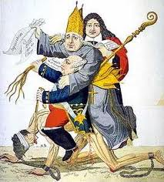
Political Cartoon

Slide 16
New Ideas of Enlightenment
In Europe:
New ideas were becoming fashionable during this period.
Philosophers and scientists began to question old ideas.
They believed in reason and the use of scientific methods to test new ideas.
All over Europe, people were talking about the different ways of ruling and questioned monarchy and the Catholic Church.
Some criticized the way society worked.

Slide 17
New Ideas of Enlightenment
In America:
The American Revolution took place in 1776.
North American colonies wanted their freedom and were prepared to fight for it.
When they won, they declared their independence from Britain.
They organized a constitution(list of rules) that their government had to follow.
France supported America in their war and these ideas quickly spread through France.

Slide 18
New ideas of Enlightenment
The French generals and soldiers who had fought in the American Revolution, returned to France with revolutionary ideas and inspired the people to fight against their unjust, despotic(authoritarian) government.
The success of the American revolutionaries enthused the French people and encouraged them to rebel.

Slide 19
New Ideas of Enlightenment
In France:
Discontent is not enough to make a successful revolution.
Someone must help the discontented to focus on the ‘enemy’ and provide ideals to fight for.
Revolutionary thinking and ideas must precede revolutionary action.
In the 18th century, France had many revolutionary thinkers.
Without the spread of their ideas, the French Revolution would simply have been an outbreak of violence.

Slide 20
New Ideas of Enlightenment
In France:
People soon began to challenge the ancien regime.
Philosophers and thinkers criticized the way the king ruled.
They argued that the Catholic Church had too much power over ordinary people.
Most people in France did not think of any violent changes but they had begun to think that their lives could be different.

Slide 21
The Age of Reason
Because of the ideas expressed by the French Intellectuals, the 18th century has been called the Age of Reason.
The philosopher- writer, Montesquieu, thought that constitutional monarchy was the most suitable form of government and outlined the principles for this form of government.
Rousseau asserted sovereignty and democracy.

Slide 22
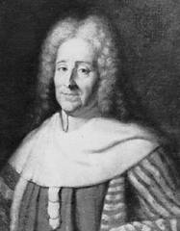
Montesquieu (Mon·tes·quieu)

Slide 23
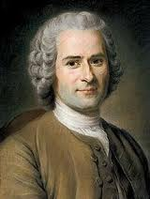
Rousseau (Rous·seau)

Slide 24
Influence of New Ideas
The revolutionary writings and ideals of great political philosophers created an intellectual agitation and excitement in France.
The middle class was greatly impressed by the revolutionary ideas of liberty, equality, fraternity and sovereignty.
Through their writings, the philosophers exposed the evils of the French Society and government and inspired the people to revolt and fight for their rights.

Slide 25
Outbreak of the Revolution
In August 1788, King Louis XVI called the Estates General (a gathering of representatives from all three estates) for the first time since 1614.
The Estates General met at the palace of Versailles, just outside Paris, in May 1789.
The king hoped the Estates General would approve new taxes.
The nobles and the clergy hoped they would control the affairs to continue their privileged lifestyles.
The middle classes hoped for an English style democracy.
The peasants hoped for solutions to their problems and were asked by their representatives to draw up lists of complaints. (cahiers)

Slide 26
The King summoned the Estates General to Versailles, where he had a body of troops.
Some saw this as an attempt to frighten the representatives.
He did not present them with any proposals for discussion, so they were left to think up their own ideas.
This meant that Louis did not have control of the meeting.

Slide 27
The National Assembly
On 17th June, 1789, members of the Third Estate, representing 96% of the population, declared themselves the National Assembly.
This would replace the Estates General and make decisions about ruling France from now on.
They wanted to draw up a constitution showing how France was to be governed.
On 20th June, they found their meeting hall occupied by royal guards.
Determined to meet, they moved to the nearby tennis court to work out a constitution.
They pledged an oath (The Tennis Court Oath) not to leave until the King agreed to meet their demands.
The Third Estate was now joined by some dissatisfied clergy and noblemen.

Slide 28
Louis then made preparations to break up the Assembly.
Troops were called.
Rumors spread that leading members of the Assembly would soon be arrested.
This enraged the people, who began to gather in their thousands.
They were soon joined by the guards.

Slide 29
Storming of the Bastille
On July 14th, 1789, the mob rioted and attacked the royal fortress prison called the Bastille.
They saw the Bastille as a symbol of everything that was wrong with France.
It was a symbol of the King and his government and the Paris mob wanted it destroyed.
The y released some prisoners, killing anyone who stood in their way.
News of the event soon spread all over France and abroad, appearing in newspapers, pictures and stories.

Slide 30
Fall of the Bastille
After a four-hour siege, the mob broke open the doors.
The fall of the Bastille symbolized the fall of autocracy.
Every year, July 14th is celebrated as a national holiday in France.
After July 14th 1789, Louis XVI was king only in name.
The National Assembly began to enact laws.
The revolt soon spread to other towns and cities and finally into the countryside.

Slide 31
Declaration of the Rights of Man
Soon after the fall of the Bastille, the National Assembly adopted the famous Declaration of the Rights of Man.
It specified –
the equality of all men before the law
eligibility of all citizens for all public offices
freedom from arrest or punishment without proven causes
freedom of speech and freedom of press
Equal distribution of the burden of taxation and rights of private property

Slide 32
The Legislative Assembly
The old National Assembly was replaced by the Legislative Assembly.
This Assembly took over the property of the people that had fled.
In June 1791, the king and the queen try to escape to Austria, but are arrested and brought back to Paris.
In April 1792, the revolutionaries declares war on Austria as rumours of an Austrian invasion become strong.
Soon, France was fighting Austria and Prussia.

Slide 33
Contd
Anyone opposed to the Constitution or in favour of the monarchy is killed.
This includes priests, who are thought to be traitors.
The king and queen are imprisoned as, their power is removed and France is declared a Republic.

Slide 34
The National Convention
In September 1792, a group called the National Convention is set up, replacing the National Assembly.
The king and queen, seen as a threat to the Republic, were put on trial and found guilty. They were executed by guillotine in 1793.

Slide 35
The Reign of Terror
A radical group known as the Jacobins, who believed in direct democracy, came to power.
Fearing that the revolution was in danger, this group took strong measures to crush forces who were a potential threat to the Revolution.
In 14 months, about 17,000 people, including those who were innocent, were tried and executed.
Some people have called it the ‘Reign of Terror’.

Slide 36
The Directory
The Directory or Directorate was a body of 5 directors that held executive powers in France following the ‘reign of terror’.
This period was marked by corruption and financial difficulties .
Soon there was conflict among the Directors.
The army had become increasingly powerful and this led to the rise of Napoleon Bonaparte.

Slide 37
Consequences of the French Revolution
A major result was the destruction of feudalism in France.
Church lands were bought by the middle classes.
The lands of the nobles were confiscated.
Privileged classes were abolished.
The French Revolution gave the term ‘nation’ its modern meaning- it is not the territory that people belonging to it occupy, but the people themselves.

Slide 38
From this followed the idea of sovereignty- the people are the source of all power and authority. The nation recognizes no law above its own.
In 1792, for the first time in history, peasants and workers were given equal political rights.
France soon became one of the first countries where ideas of social equality gave rise to a new kind of political movement.

