Slide 1
Indian National Congress
Grade 8

Slide 2
Meaning of Nationalism
Dictionary meaning:
Loyalty and devotion to a nation; especially : a sense of national consciousness exalting one’s nation and placing primary emphasis on promotion of its culture and interests.

Slide 3
Nationalism in India
It had to be cultivated
The meaning had to be explained to people
People were blinded by caste differences, religion, language and region
It took time for India to emerge

Slide 4
There were two things happening simultaneously – social reform and political agitation

Slide 5
Rise of Indian Nationalism
The English continued with their repressive measures (control/suppress) against Indians.
In 1878, The Arms Act forbade Indians from possessing arms.
The Vernacular Press Act placed severe restrictions on the newspapers in Indian languages.
These were the immediate reasons which required anall-India organization representing Indian opinion.

Slide 6
Indian National Congress (INC)
Owes its origin to a retired English Civil servant – A.O.Hume.
He appealed to the young graduates of Calcutta University to form an association for the moral, social and political revival of Indians.
He later addressed an open letter to educated Indians, inviting them to join the venture.
The first session of the INC was held in Bombay in December 1885, attended by 72 delegates.

Slide 7
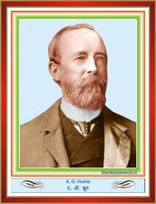
Allen Octavian Hume – responsible for the origin of the INC

Slide 8
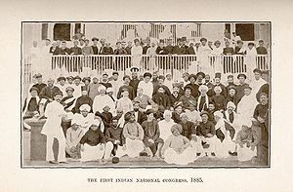
First session of Indian National Congress, Bombay, 28–31 December 1885.

Slide 9
Chief Aims of the Indian National Congress
To promote friendly relations among nationalist workers in different parts of the country.
To develop and strengthen feelings of national unity throughout the country.
To formulate popular demands and to place them before the government.
To train and organise public opinion in the country.
To bring together leaders from different parts of the country.
To remove racial, religious and caste prejudices.

Slide 10
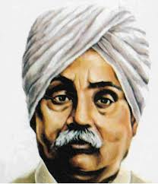
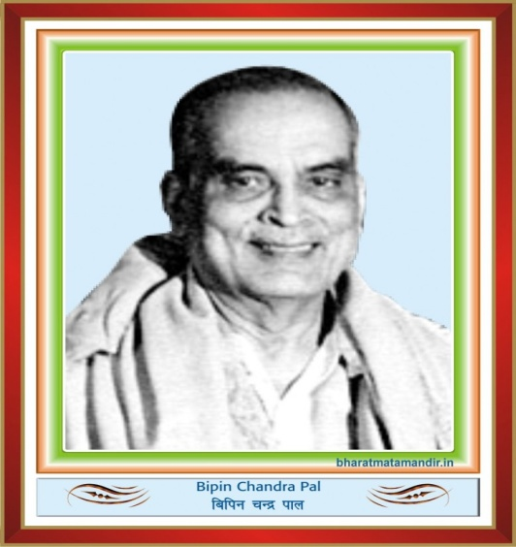
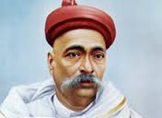
Lal, Bal, Pal – Extremists who demanded radical changes
Lala Lajpat Rai
Bal Gangadhar Tilak

Slide 11
Three Phases of the Movement led by the INC
Phase 1 – Moderate leaders (Gopal Krishna Gokhale, Dadabhai Navroji, SN Banerjee )
Phase 2 – Extremist leaders (Aurobindo Ghosh, VD Savarkar)
Phase 3 – Non-violence and non- cooperation under the leadership of Mahatma Gandhi

Slide 12
Moderates
The INC leaders of the first phase were called ‘moderates’ because –
Their demands were modest and mild
They wanted to bring about changes peacefully
They had faith in the British administration and hence, wanted ‘Swaraj’ within the British Empire or ‘dominion status’.

Slide 13
Demands made by Moderates
Reduce land revenue.
Bring changes in government economic policies to help growth of Indian industries.
Recruit Indians to higher posts.
Cut expenditure on administration and army.
Expand welfare programmes and promote education.

Slide 14
Methods used by Moderates
Even when criticizing government policy, they maintained moderation of language.
Their aim was to arouse British conscience to do justice to the demands of the Indians.
They carried out propaganda through the press.
They held annual meetings and placed their demands before the government through resolutions and petitions.
Commissions were also sent to England to explain their viewpoint.

Slide 15
Attitude of the British
Initially, the British looked at the Congress movement with favour.
Government officials attended meetings and took part in discussions.
As the demands for reforms increased, the attitude of the government became hostile and the Congress was branded a seditious (disruptive) organization .
Gradually, the officials kept away from meetings.

Slide 16
Contribution of Moderates
Organised public opinion and placed it before the government.
They were men of wisdom, character and patriotism who promoted nationalism.
They paved the way for a united national struggle.
They prepared the base for the ‘radical movement’.
They raised the national movement to a higher level.

