Slide 1
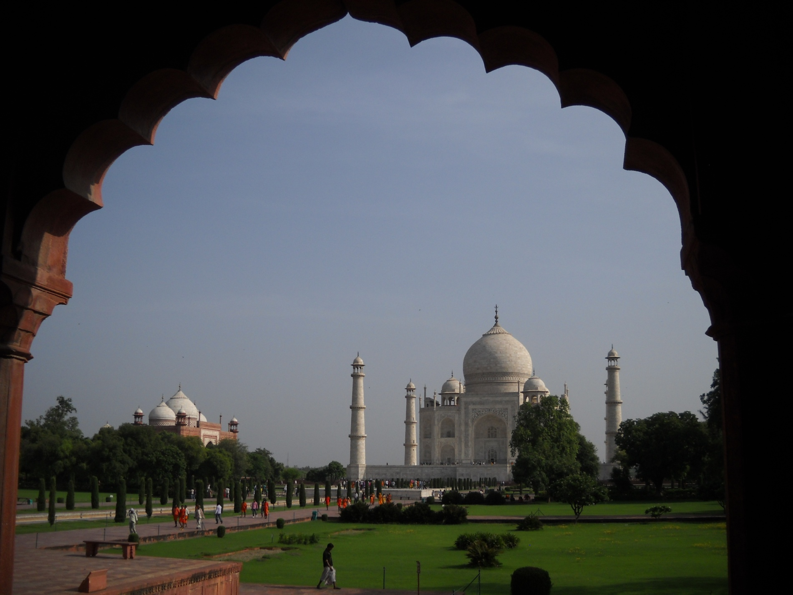
Mughal Architecture
Akbar to Aurangzeb

Slide 2
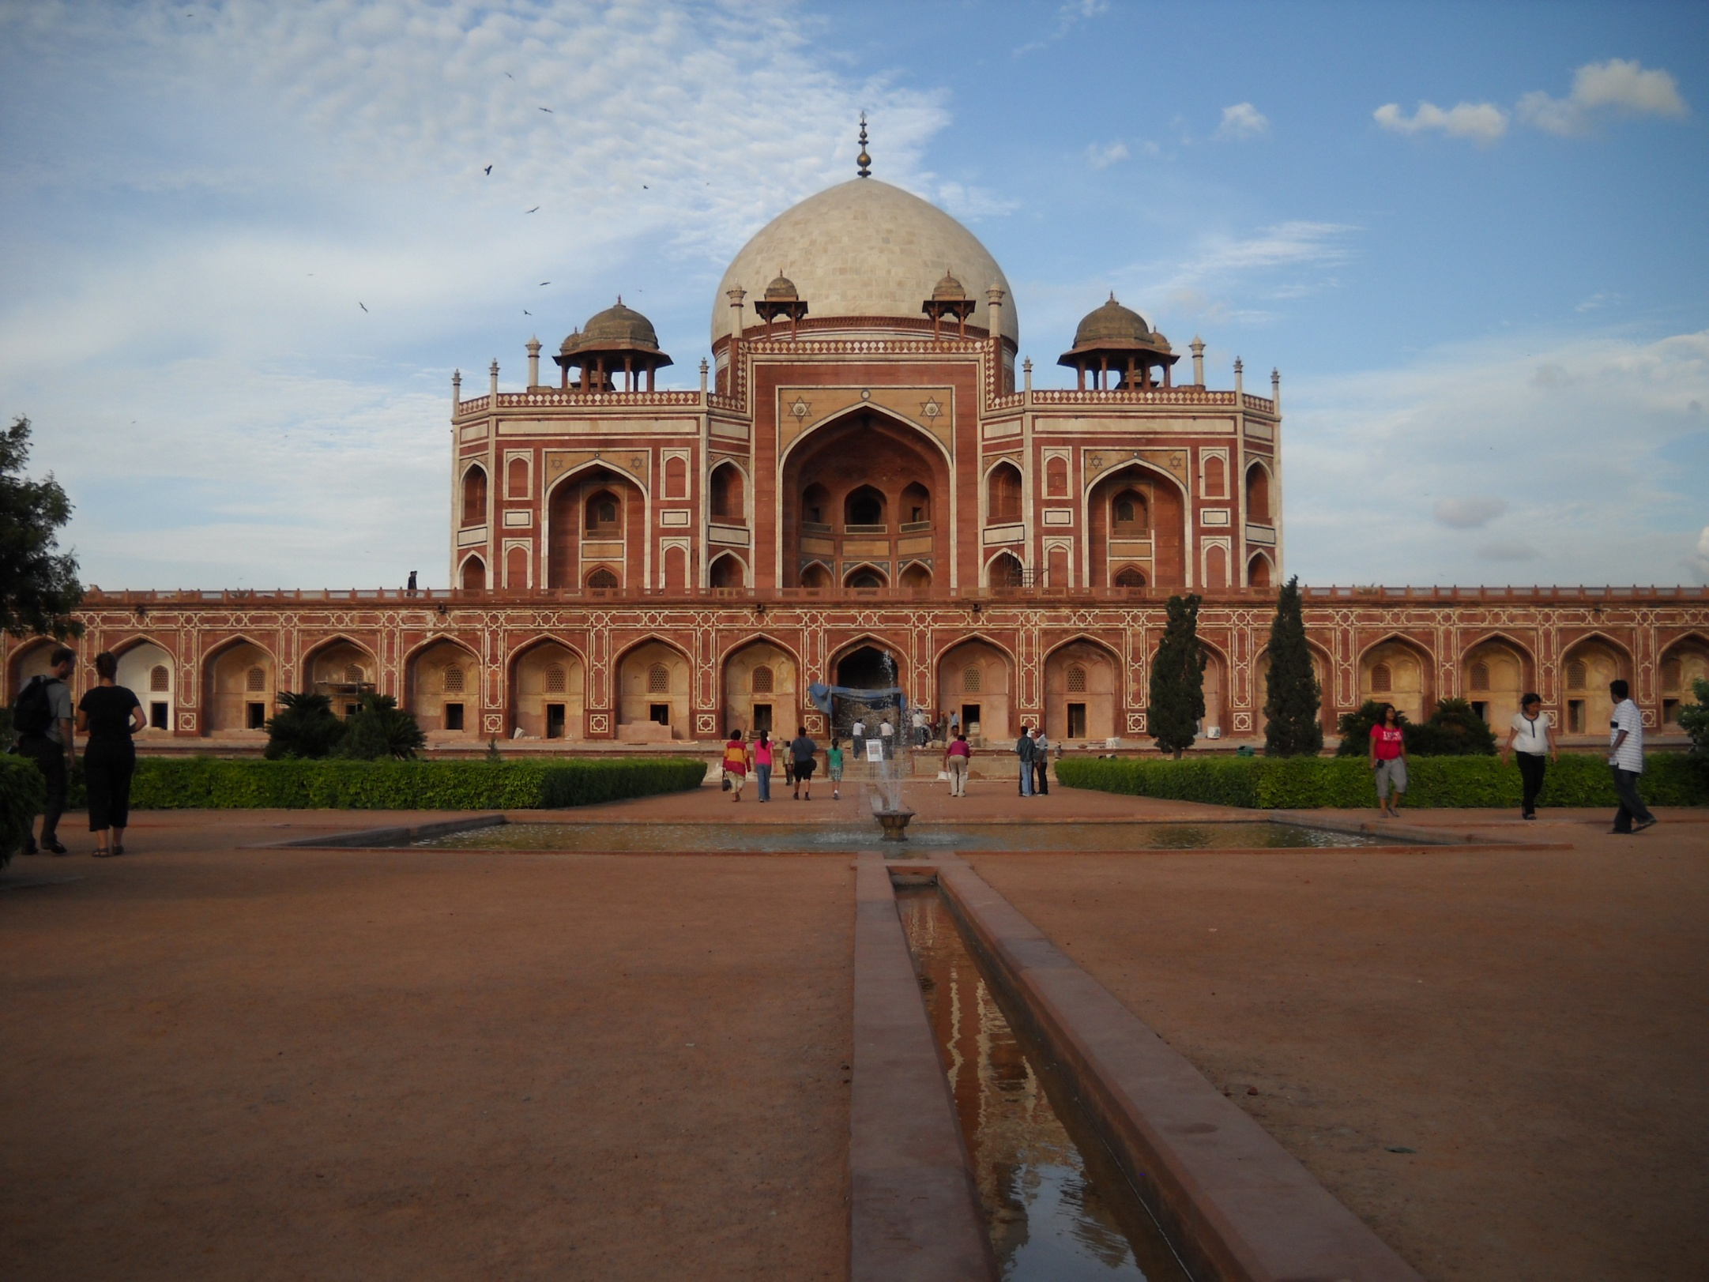
Humayun’s Tomb, at Delhi- the first of the great Mughal monuments that marks them out for greatness. The Mughal legacy continues in India – its beautiful monuments, gardens and forts not only aid the local economy through tourism, but through the Taj Mahal define India’s image to the global community and to Indians themselves.
Humayun’s tomb in Delhi is an early example- octagonal shaped resting on a huge square platform in the middle of a four-sectioned garden(charbagh), topped by a huge dome; with a water channel running in the middle in a straight line on either side and reflecting the monument in its almost still waters.

Slide 3
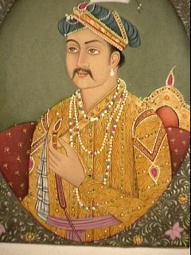
Akbar’s Contribution
Mughal architecture begins with Akbar
It is a blend of Persian and Hindu styles
Most of Akbar’s buildings are in red sandstone
In 1565 A.D. Akbar started the construction of the massive Agra Fort.
His most magnificent legacy is the new capital he built at Fatehpur Sikri, 40 kms from Agra; it had to be abandoned in his life time because of lack of water; buildings consist of palaces, courtyards, reflecting pools, tombs and the Jami Mosque.
Construction of his tomb began in his reign but was completed by Jehangir.

Slide 4
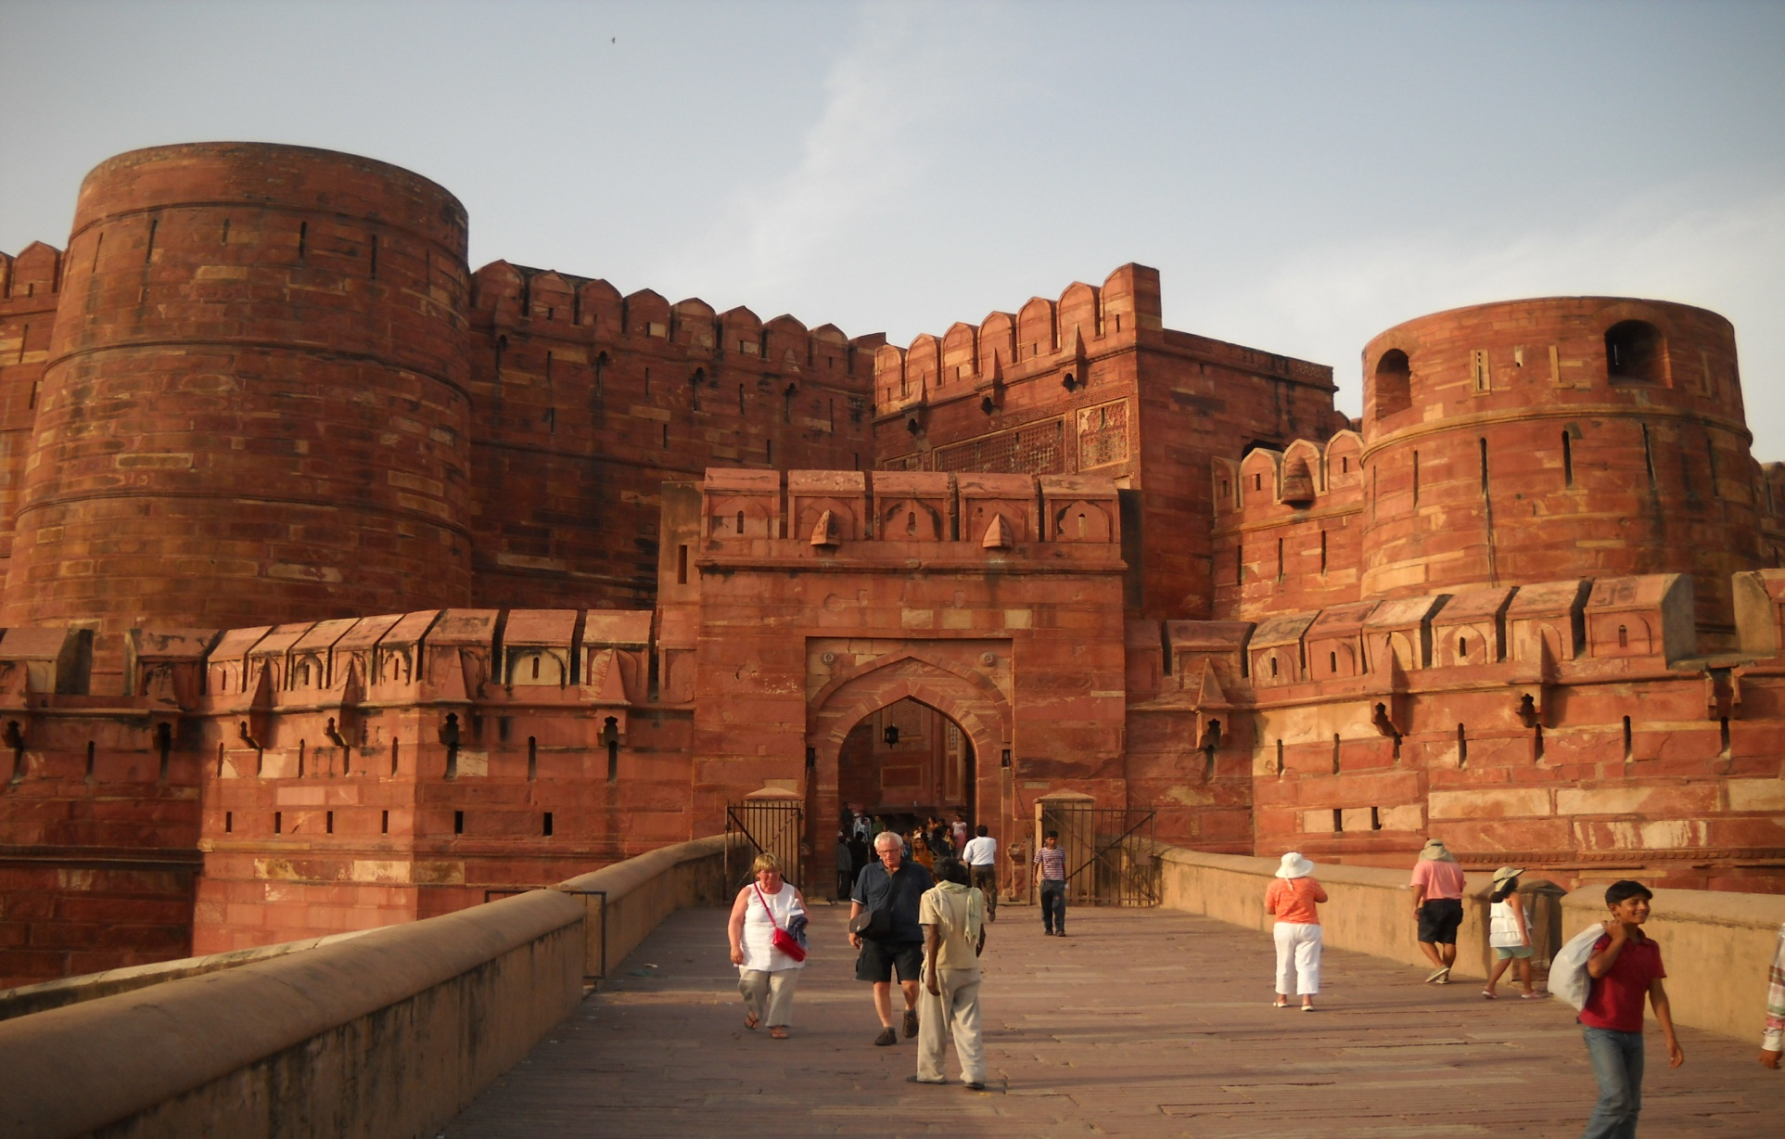
The Agra Fort
Built by Akbar, the fort underwent major changes in its history.
During Shah Jehan’s reign several buildings were demolished to make way for open airy pavilions, palaces and mosques in marble.

Slide 5
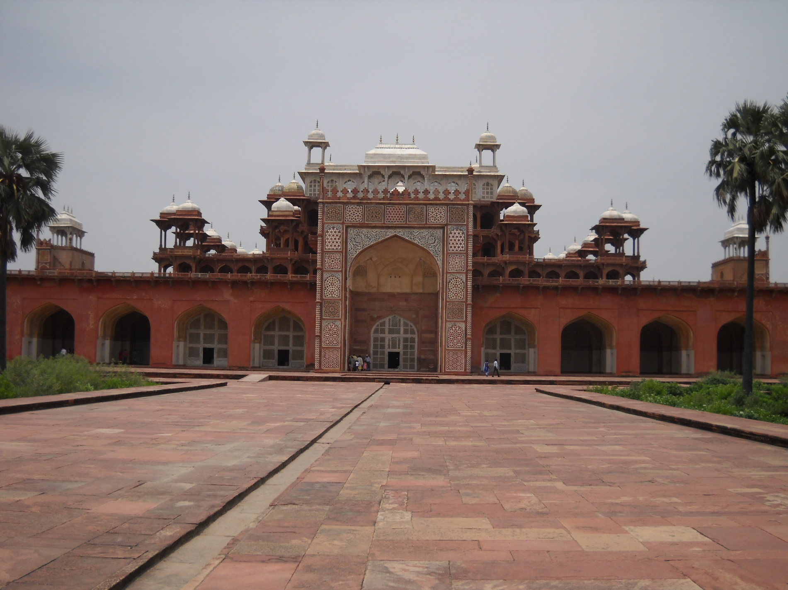
Akbar’s tomb in Agra It lacks a central dome- typical of architecture under Jehangir It is mostly in red sandstone

Slide 6
Akbar’s tomb
The mausoleum is set in the centre of a huge walled garden on a raised platform.
There are four large gateways on each side; each a magnificent monument in its own right.
The main gateway (shown here) is the largest. It has intricate geometrical patterns in contrasting red and white stone and marble, its beauty and magnificence overshadows the main monument.

Slide 7
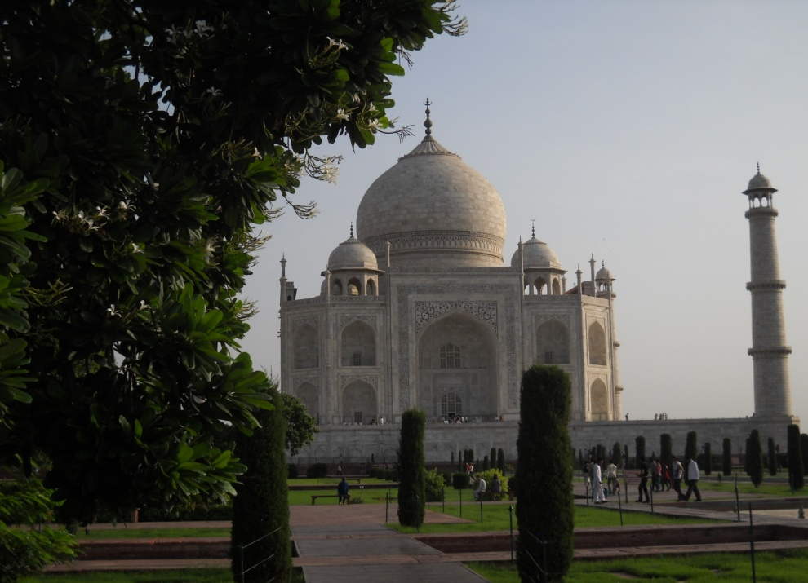
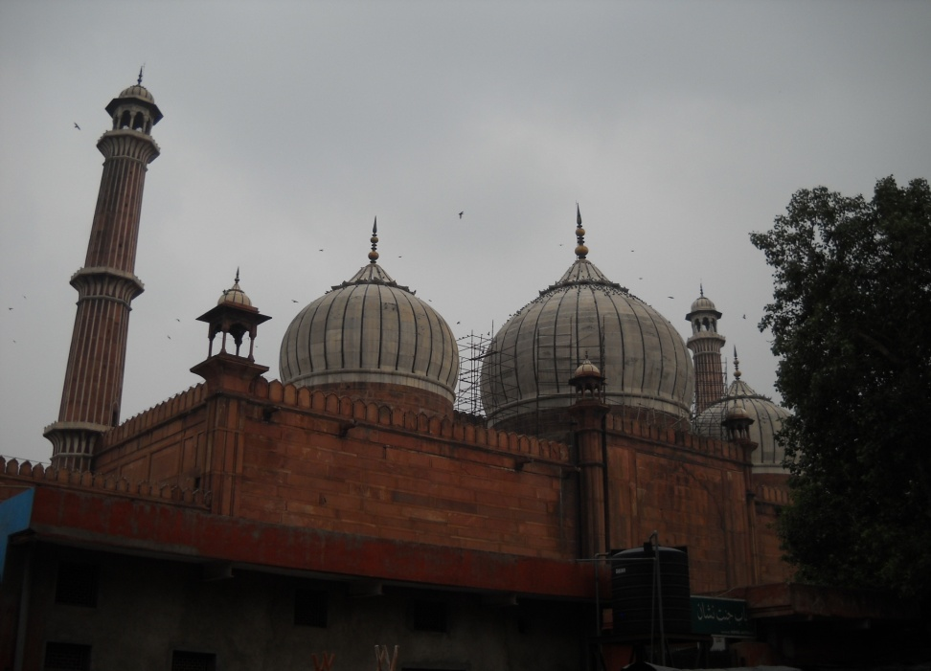
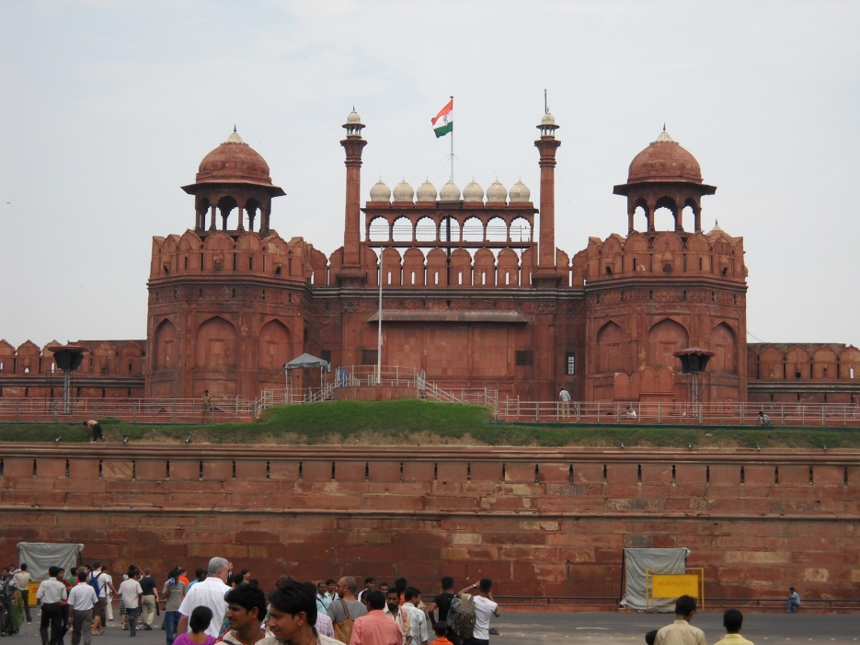
Shah Jahan’s Legacy
Shah Jahan’s reign is known in history as the Golden Era of Mughal Architecture
He built a new capital called Shahjahanabad on the banks of the Jamuna river in Delhi. The Red Fort, the huge Jama Masjid and the Chandni Chowk are his architectural legacies that live on in Delhi.

Slide 8
The Taj Mahal

Slide 9
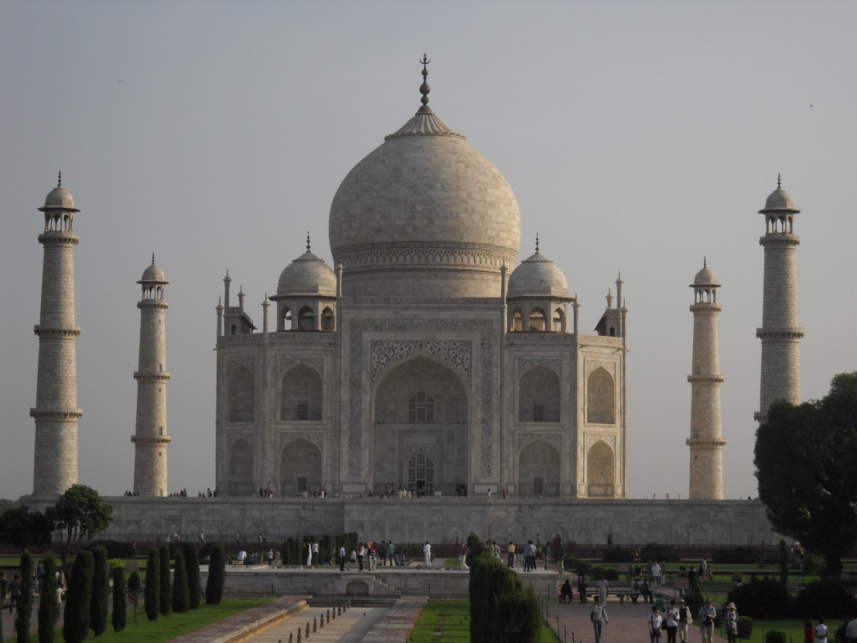
The Taj Mahal
History
Shah Jahan’s chief queen was Arjumand Bano, daughter of a Persian nobleman, Asaf Khan, who was Prime Minister under Jehangir. She was given the title Mumtaz Mahal (Light of the Palace)
She was extremely loyal to Shah Jahan and willingly underwent many hardships for several years when Shah Jahan was out of favour from the royal court and was either in exile or being chased by Mughal forces. She chose to be by his side, rather than live in comfort in the royal palaces in Agra.
In 1631 she died while giving birth to their fourteenth child at Burhanpur, leaving Shah Jehan grief stricken
Shah Jahan decided to construct a mausoleum in her memory whose beauty would symbolise the greatness of his love.
He chose a site in Agra on the banks of the Yamuna, where the river curves. Work started in 1632.
The construction of the Taj Mahal used thousands of workers, who laboured under the orders of several architects, chief among them being Ustad Ahmad Lahori

Slide 10
The Taj Mahal- features
Inspired by the tomb of Humayun at Delhi, it is octagonal in shape, built on a raised square platform and topped by a bulbous dome. However, instead of being placed in the middle of the garden, it is placed at the end.
There is a garden on the same axis to the Taj on the other side of the river, thereby making the Yamuna a part of the overall grand design as the river in ‘Jannat’(Heaven)
The Taj is at the centre of a huge complex of buildings both secular and religious. There is a mosque to the immediate north of the Taj, a guesthouse on the south side and pavilions on the side walls. There are four gates to the walled enclosure, three of them false. A broad water channel with fountains starts near the entrance gate and runs to the platform.
The perfect symmetry of the Taj is balanced by four delicately shaped minarets , each placed at the corner of the square platform on which the Taj stands. The minarets have been designed with a slight tilt away from the Taj, so that in the event of an earthquake they will fall away from the monument. The minaret closest to the mosque is used as a muezzin’s tower to call the faithful for prayers.

Slide 11
The Taj Mahal- features contd..
The garden is in typical Mughal ‘charbagh’ style (square garden, partitioned into four equal sections by water courses or walking paths) Originally, beds planted with flowers of various kinds and fruit trees contributed to the image of Paradise (Jannat) as evoked by the Koran.
The allusion to Paradise is also stressed by the pietra dura etchings of flowers and foliated scrolls in semi-precious stones that adorn the inner walls of the Taj. The inner sanctum at one time also had precious stones, gold and silver wall linings, much of it was looted through the centuries leaving the Taj even more beautiful in its white simplicity.
The main hall, where the cenotaphs of Shah Jehan and Mumtaz Mahal are placed, is octagonal in shape evoking the eight gardens of Paradise(Jannat). The real tombs are in an underground chamber below the main hall.
The Taj’s perfect symmetry was broken when Shah Jehan was laid to rest by his wife’s side.
The Taj is not a solid marble building. The marble is used as outer cladding on an internal brick structure. The marble is unique in its whiteness and is from Makrana in Rajasthan.

Slide 12
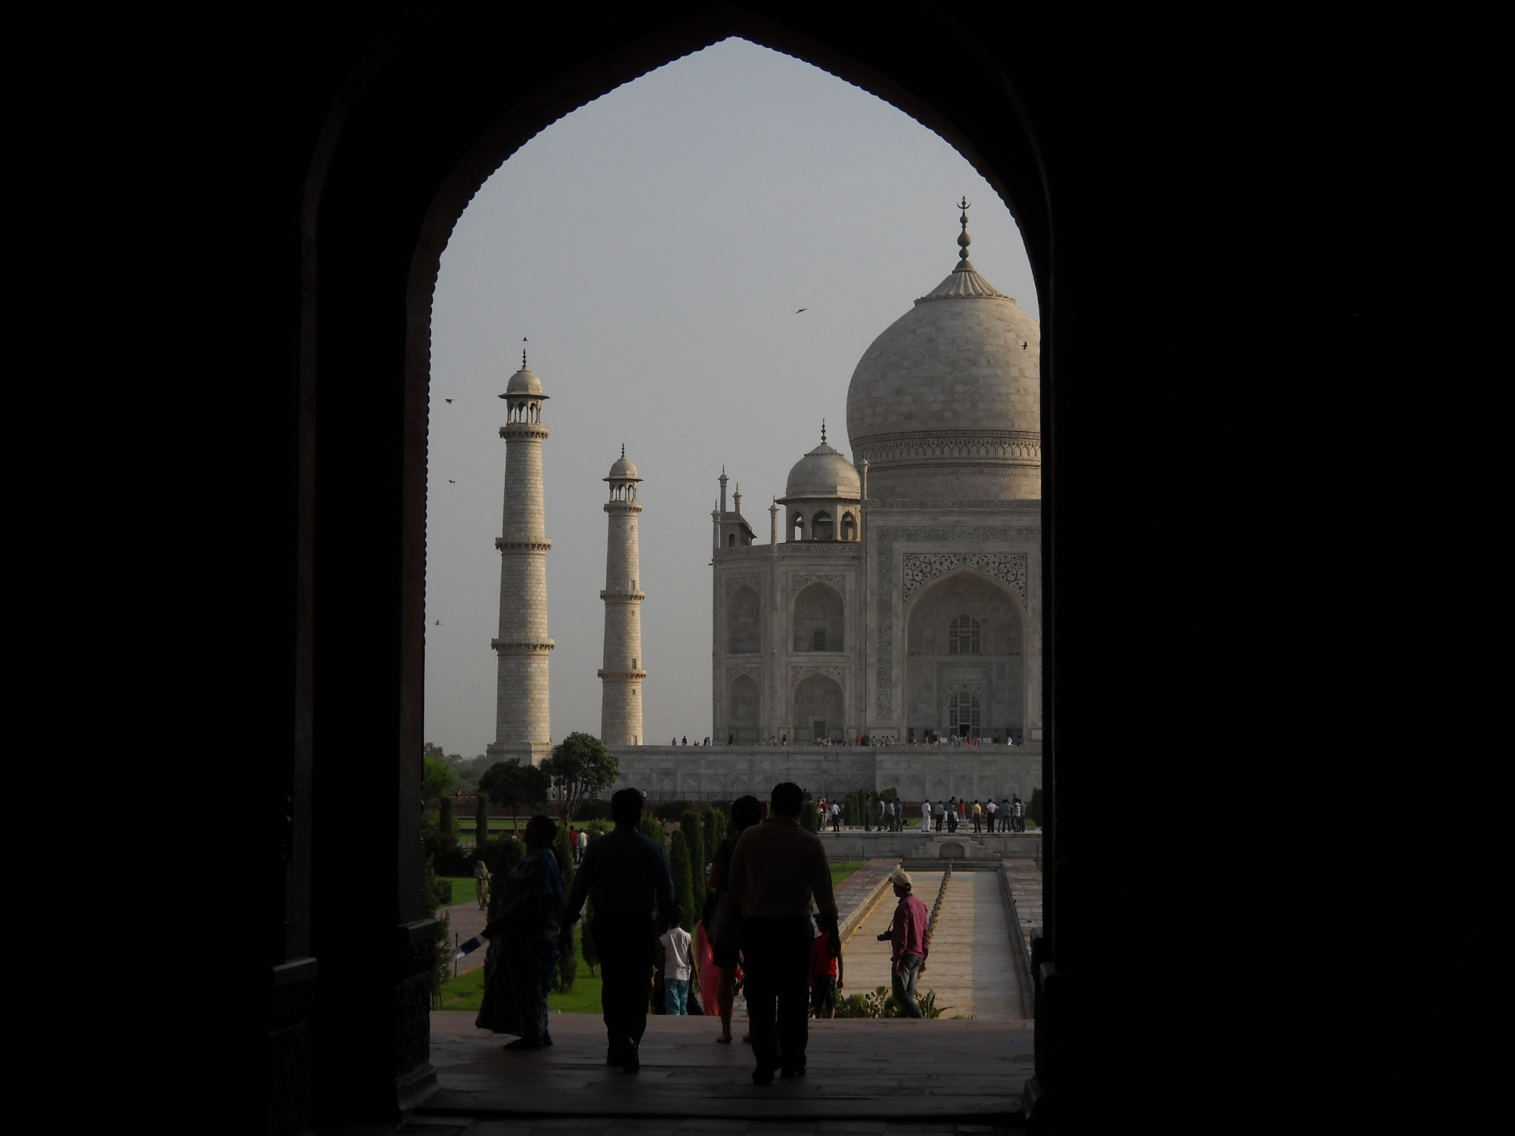

Slide 13
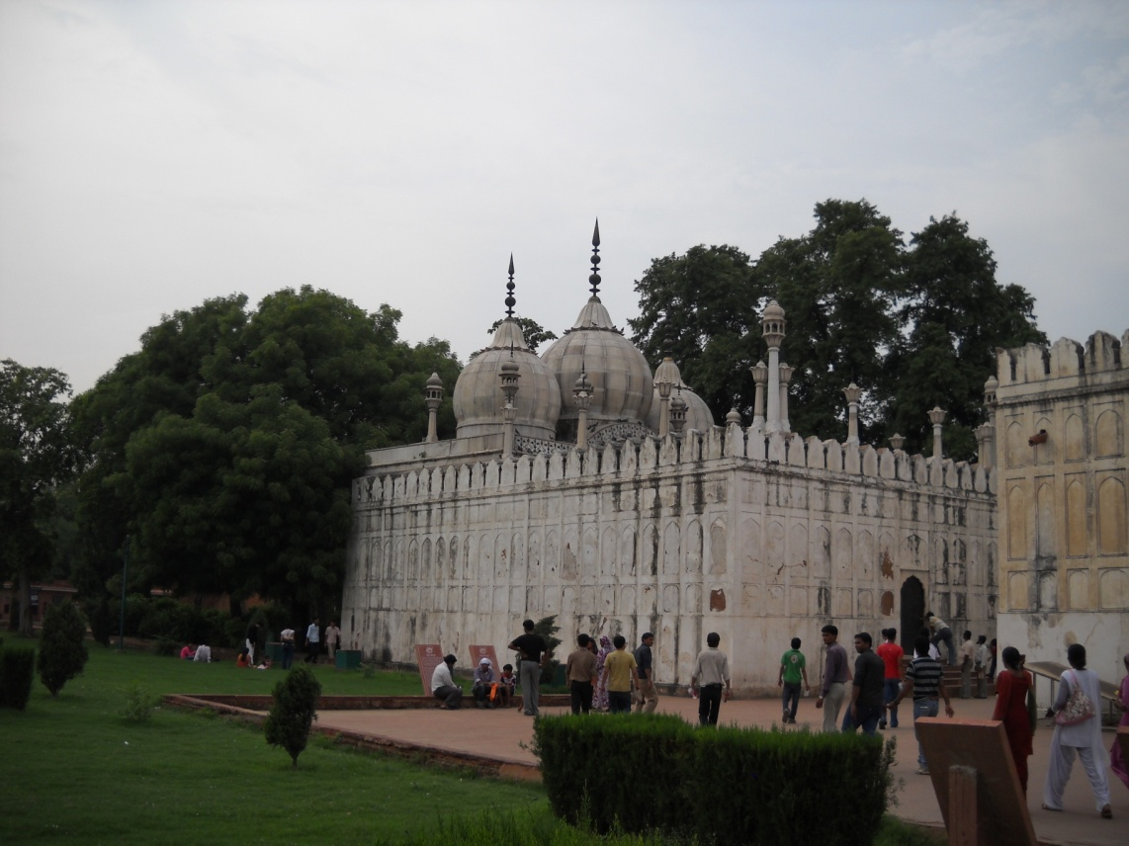
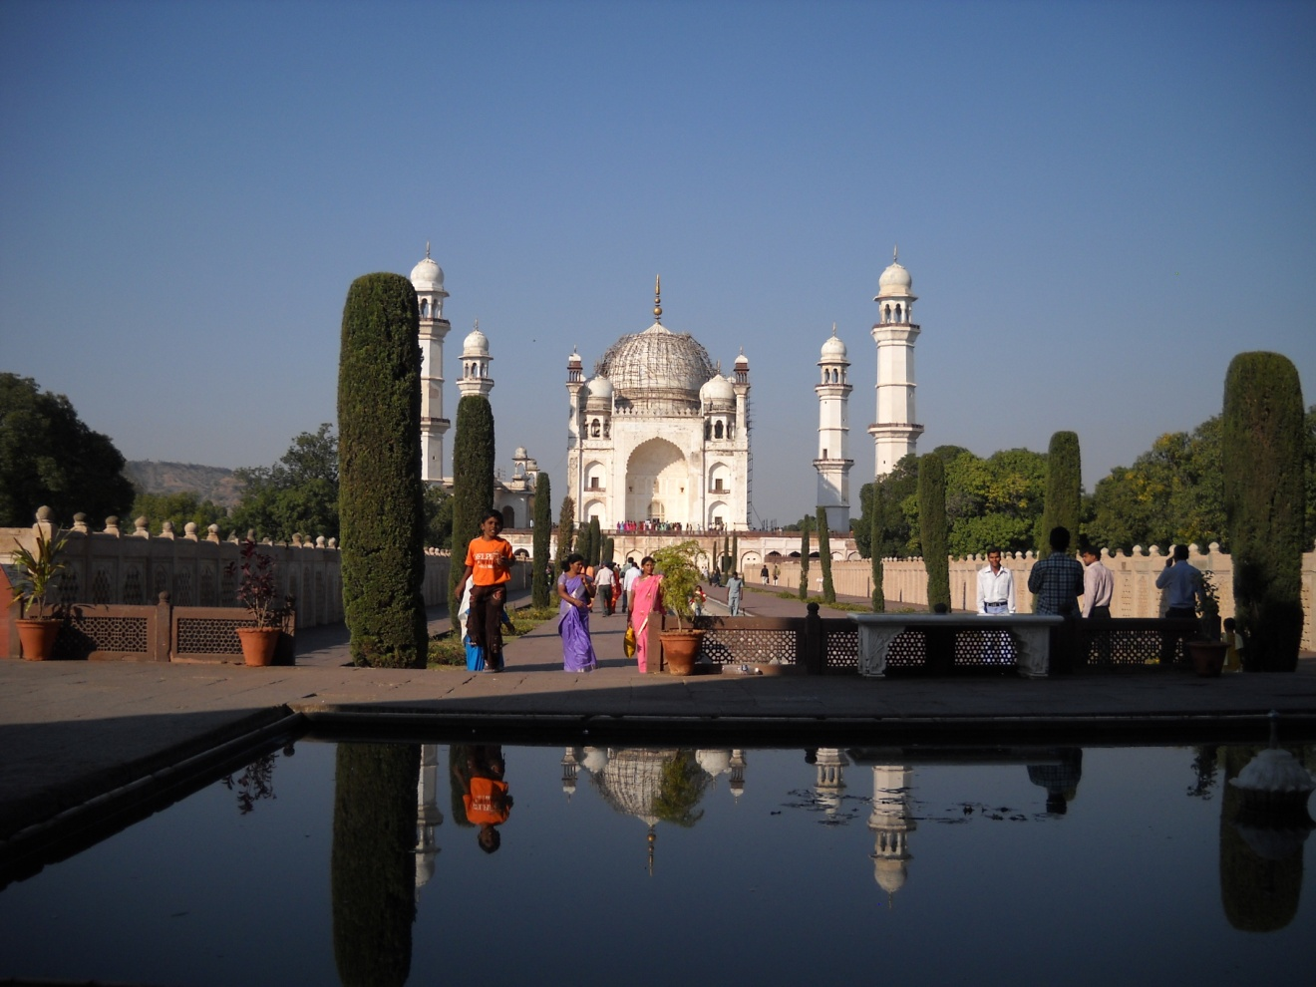
Aurangzeb
Aurangzeb’s contributions to architecture are few in comparison to his predecessors.
He constructed the beautiful Moti Masjid in the Red Fort (above) and a tomb for his queen at Aurangabad (right)

