Slide 1
THE MUGHALS - Babur
Grade 7

Slide 2
Background
The Delhi Sultanate had become weak and reduced in power. Its control was limited to Delhi and its surrounding areas.
There was political disunity and India was divided into a number of small kingdoms ruled by independent kings.
This was a perfect situation for Babur, a descendent of Timur, to conquer India.

Slide 3
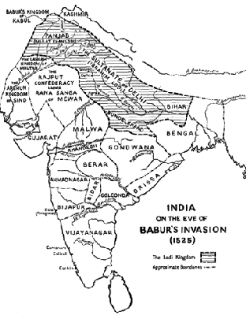
India on the Eve of Babur’s Invasion

Slide 4
BABUR
He was the founder of the Mughal Empire.
In 1524 AD, Daulat Khan Lodi invited Babur to invade India and help him to overthrow Ibrahim Lodi, the cruel and unpopular Sultan of Delhi.
It was a golden opportunity and Babur seized it.
Within three weeks of crossing the Indus, Babur became the master of Punjab.

Slide 5
The First Battle of Panipat
Babur and Ibrahim Lodi came face to face at Panipat in 1526 AD.
Ibrahim’s large army was no match for Babur’s small, disciplined and loyal army with its excellent cavalry (soldiers on horses) and fine artillery (weapons), superior techniques and skill
Babur was a brilliant leader and an experienced military general.
Within a few hours, Ibrahim’s army was routed (defeated).

Slide 6
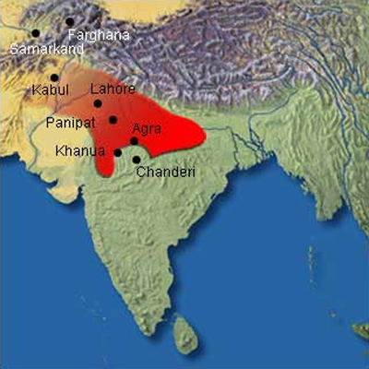
Panipat on the map of India

Slide 7
By evening, Ibrahim and 15,000 of his soldiers lay dead on the field.
The following day, Babur triumphantly entered Delhi where he was proclaimed the emperor of Hindustan.
He made up his mind to stay and consolidate (strengthen)his position in India.

Slide 8
Babur’s Strengths
He was a brilliant general.
He defeated large armies with his superior techniques and skills.
He destroyed the power of the Lodis and the Rajputs and laid the foundation of the Mughal empire.
He was tolerant towards people of other faiths.

Slide 9
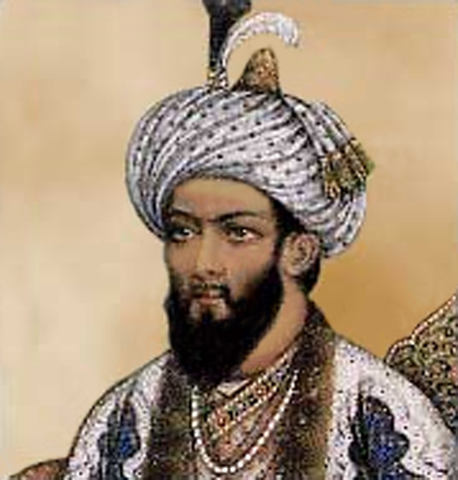
Emperor Babur

Slide 10
Babur’s Strengths (continued)
Babur was an accomplished poet and writer, an excellent musician, a great scholar and a lover of literature.
He loved gardens and laid put many beautiful gardens in the territories that he had conquered.
It is said that after the First Battle of Panipat, his soldiers were tired and homesick and did not want to fight another war. With an eloquent (expressive and forceful)and impassioned (deeply moving) speech, he transformed his war-weary soldiers into an army of heroes.

Slide 11
Babur died in Agra, shortly afterwards in 1530 AD, at the age of 48.
He was buried in Kabul in accordance with his wishes.
Humayun, the eldest of Babur’s four sons, was nominated by Babur as his successor to the throne.

