Slide 1
The Mughals- JAHANGIR
Grade 7

Slide 2
Jahangir 1605 - 1627 The Paragon of Stability
Jahangir succeeded his father Akbar in 1605.
In comparison to his father’s conquests, Jahangir’s achievements were less spectacular. However, he held the vast empire together with great efficiency.
He continued many of Akbar’s policies.
Freedom of worship.
Fair treatment of Hindus.
Continued friendship and alliance with Rajputs.
Allowed foreigners like the Portuguese and English into India for trade.
Jahangir married Nur Jahan. She became the real ruler of the empire until the death of her husband.

Slide 3
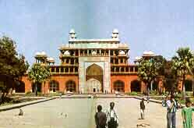
Jahangir Issues (specific)
Under the influence of his wife and many others, Jahangir was not an able ruler like his father.
He loved to drink and enjoy himself.
He had to suppress many rebellions.
Important posts in the court were given to families, friends, and especially those close to his wife, Jahan.

