Slide 1
The Mughals- AKBAR THE GREAT
Grade 7

Slide 2
INTRODUCTION
After Humayun’s death, his thirteen year old son, Akbar, was proclaimed emperor.
As Akbar was too young, Bairam Khan, Humayun’s faithful and experienced general, looked after the affairs of the government on his behalf.

Slide 3
POLITICAL CONDITION
The Mughal throne was unstable and insecure.
It was threatened by enemies on all sides.
Adil Shah, the nephew of Sher Shah, was determined to re-establish the Afghan rule by capturing the throne of Delhi.
The Rajputs had become powerful and were waiting for an opportunity to overthrow the Mughals.

Slide 4
SECOND BATTLE OF PANIPAT
When? - November 1556
Important personalities –
Hemu – chief minister of Adil Shah
Bairam Khan
Sequence of events-
In October 1556, Hemu occupied the city of Delhi and declared himself the ruler.
Bairam Khan decided to face the challenge.
In November 1556, the two armies met on the historic battlefield of Panipat.
Hemu was defeated and killed.
This battle crushed the Afghan power and removed the threat to Akbar’s throne.

Slide 5
Bairam Khan’s Rule
For the next four years, Bairam Khan managed the affairs of the state on behalf of Akbar.
During this period, he conquered Gwalior, Ajmer and Jaipur.
In 1560 AD, at the age of eighteen, Akbar decided to take charge.
He dismissed Bairam Khan and assumed absolute power and authority.
His aim was to bring the entire country under his control.

Slide 6
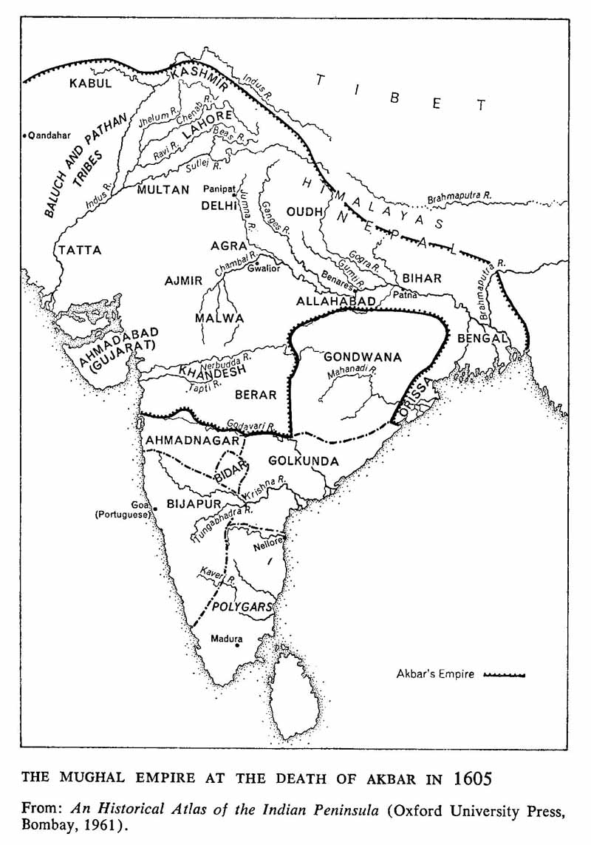
EXTENT OF AKBAR’S EMPIRE

Slide 7
ADMINISTRATION OF AKBAR
One of the greatest achievements of Akbar was the establishment of an excellent administrative system.
Important Features:
Central Administration (centralised government)
Provincial Administration (the vast empire was divided into fifteen provinces)
The Mansabdari System (every official was given a ‘rank’ or ‘mansab’)
Economy (Revenue System (taxation) and trade)

Slide 8
CENTRAL ADMINISTRATION
A centralised government was set up in order to keep the vast empire together.
The emperor was assisted by a team of ministers.
The emperor was the commander-in-chief of the armed forces and the supreme judge on all matters of justice. His word was law.
The success of this system depended largely on the personality of the emperor and his wisdom to choose the right person for the right job.

Slide 9
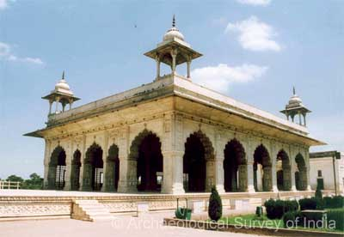
Central Administration (continued)
Diwan-i-Khas – the private audience hall where meetings were held with senior officers.

Slide 10
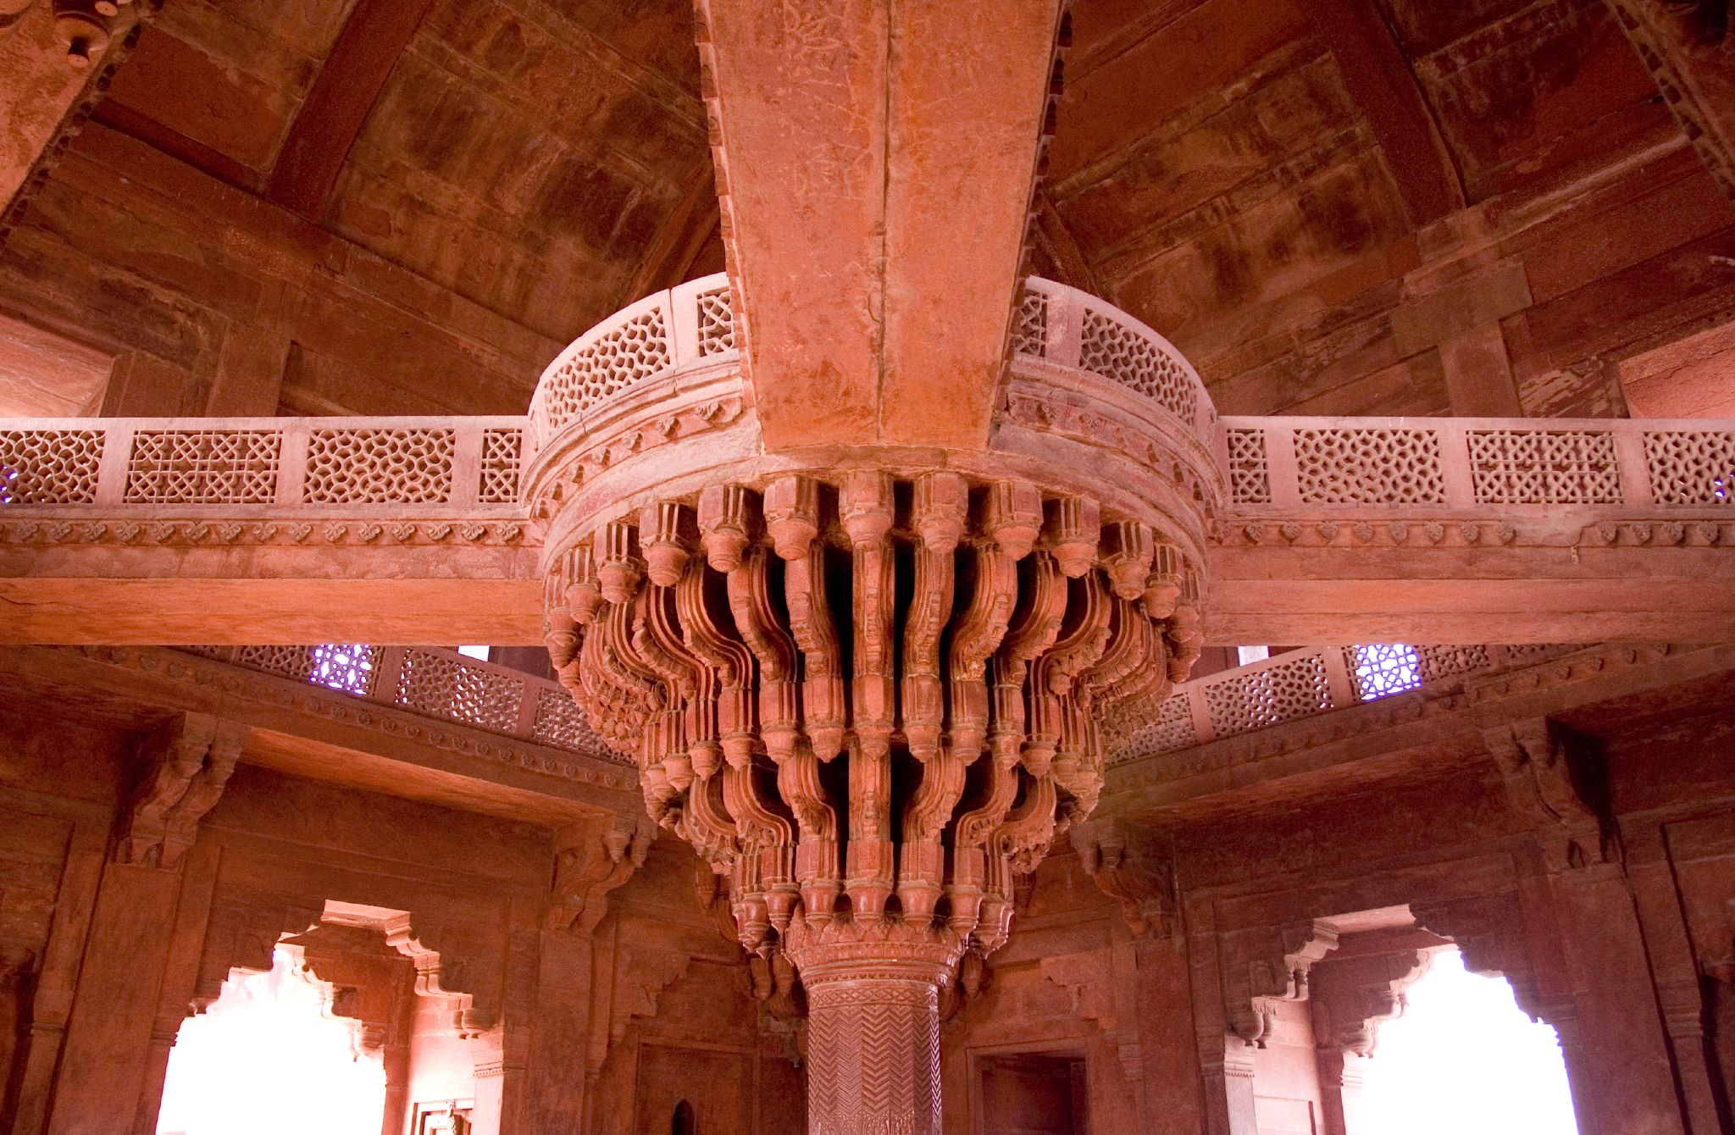
DIWAN-I- KHAS (interiors)

Slide 11
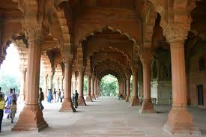
Diwan-i-Aam

Slide 12
PROVONCIAL ADMINISTRATION
In order to carry out the administration effectively, the empire was divided into 15 smaller divisions called subhas.
A governor was in charge of each subha.
The subhas were divided into districts.
Each district was further divided into parganas, which were made up of a number of villages.
Officials were carefully appointed and were paid salaries regularly.
Officials who worked well were rewarded with land grants.

Slide 13
MANSABDARI SYSTEM
Mansab is an Arabic word which means rank or position.
Every officer was given a rank (mansab), and was called a mansabdar.
It was a graded system and not hereditary.
An officer (mansabdar) entered service at a low rank and then rose to higher ranks through promotion on the basis of his performance and loyalty.

Slide 14
MANSABDARI SYSTEM (continued)
A mansabdar had to maintain a certain number of horsemen, a fixed number of elephants, camels, mules and carts.
He had to be ready with his troops whenever the emperor required his service.
However, Akbar did not solely depend on the mandasdars. He had an army of well trained soldiers and artillery under his direct control.

Slide 15
ECONOMY
LAND REVENUE SYSTEM
The main source of income for the empire was land revenue.
Land of each farmer was measured and divided into three categories – good, average and bad - according to how much grain the farmers produced.
Assessment was based on the average produce over the past ten years.
One – third of the produce was the share that had to be given to the state, either in cash or kind.
Proper records of revenue was maintained.
Raja Todar Mal was the revenue minister.

Slide 16
ECONOMY
TRADE
The second source of income for the empire was trade.
Textiles, spices and indigo were exported.
Both internal and external trade was encouraged.
Roads were constructed and maintained for this purpose.
India traded with China, Central Asia and Europe.
Gold, silver and copper coins were issued.

Slide 17
AKBAR’S RELIGIOUS POLICY
Akbar strongly believed in universal peace.
He followed a policy of religious tolerance.
He believed in equality of all religions and developed a secular (not religious) outlook.
He won over the Rajputs by allowing them religious freedom and celebrating their festivals.
Hindus were allowed to build temples, celebrate festivals and worship freely.
He married Rajput princesses and allowed them freedom of worship.
He got the Vedas and the Epics translated into Persian.
He abolished (completely removed) the tax which the non- Muslims had to pay in a Muslim country. (jaziya)

Slide 18
RELIGIOUS POLICY (continued)
He gave high posts to talented Hindus. (Todar Mal, Birbal)
He also made land grants to people irrespective of their religion.
He built a prayer hall (Ibadat Khana) in Fatehpur Sikri, where he had religious discussions with teachers and saints of all religions.
He believed that all religions preached truth and that God is one.

Slide 19
RELIGIOUS POLICY (continued)
AKBAR’S RELIGION:
Akbar suggested a new religious path in 1582 AD, which was referred to as Din-i-Ilahi (monotheism) – the religion of one God.
Every member was asked to take an oath of doing good to all.
He stopped cow slaughter and punished offenders.
They worshipped the sun, fire and light.
There were no sacred books, temples, priests or rituals.
As the membership of this new faith was voluntary, very few people accepted it.

Slide 20
AKBAR’S RAJPUT POLICY
Akbar was impressed by the patriotism of the Rajputs.
He realised that he would need their support in order to build and maintain a large and stable empire.
He treated the Rajputs with honour and equality and won their respect and loyalty.
He strengthened his ties with the Rajputs by marrying their princesses.
Akbar did not annex ()their kingdoms after defeating them in war. They were allowed to keep their kingdoms but had to pay him regular tribute.
Thus, the Rajputs formed the backbone of a strong and stable empire.

Slide 21
AKBAR’S SOCIAL AND CULTURAL ACHIEVEMENTS
SOCIAL REFORMS:
Akbar introduced a number of social reforms to rid Indian society of some cruel practices –
He abolished sati.
He legalised remarriage of widows (women whose husbands had died)
He discouraged child marriage
The consent of the bride and the bridegroom had to be taken before a marriage was performed.

Slide 22
AKBAR’S SOCIAL AND CULTURAL ACHIEVEMENTS
EDUCATIONAL REFORMS:
Akbar tried to bring about religious harmony by reforming the educational system –
He laid more emphasis on secular (non-religious) subjects such as Mathematics, Agriculture, Logic, History and Astronomy.
A translation department was set up to translate Sanskrit works.

Slide 23
AKBAR’S SOCIAL AND CULTURAL ACHIEVEMENTS
LITERATURE:
Persian was the court language and the language of the upper classes.
Persian literature was encouraged by the Mughals.
Hindi was also used in the Mughal court.
Abdul Fazal wrote the ‘Akbarnama’, which is an account of Akbar’s life.
Birbal was made the poet laureate in Akbar’s court.
The ‘Ramachartra- manasa’ was written by the greatest Hindi author, Tulsidas.

Slide 24
AKBAR’S SOCIAL AND CULTURAL ACHIEVEMENTS
Akbar was illiterate but he had an insatiable hunger fro knowledge and passion for books.
His library consisted of 24,000 books, many of which were specially written and illustrated for the emperor by calligraphists.
Printing was not known.

Slide 25
AKBAR’S SOCIAL AND CULTURAL ACHIEVEMENTS
ARCHITECTURE:
During Akbar’s long and peaceful reign, many buildings were constructed.
Akbar’s architectural style, Akbar’ was very Indian.
Inspired by Hindu rajas, Akbar’s later buildings reflect Rajput traditions.
Fatehpur Sikri, Akbar’s new capital city, contains many interesting Rajput style buildings made of sandstone.

Slide 26
AKBAR’S SOCIAL AND CULTURAL ACHIEVEMENTS
Among the many fine buildings were the Diwan-i-Khas, Panch Mahal, Jodha’s palace and the Buland Darwaza.
The famous Agra Fort was built in sandstone.
MUSIC:
Akbar was very fond of music.
According to Abdul Fazal, there thirty-six top ranking musicians in Akbar’s court.
They were divided into seven groups and each group entertained the emperor on one day of the week.
Tansen was the most famous musician in Akbar’s court.

Slide 27
AKBAR’S NINE GEMS
Akbar’s court was adorned (graced/enriched) by a host of brilliant men known as the nine gems or ‘Nava ratna’.
Abdul Fazal – scholar and historian
Faizi – Persian poet laureate and philosopher
Abdur Rahim – Hindi poet and composer of ‘dohas’
Tansen – singer and musician of extraordinary talent
Todar Mal – brilliant revenue minister
Birbal – Akbar’s constant companion, famous for his intelligence and sharp wit.
Raja Man Singh – a great military commander and trusted advisor of the emperor.
Human – well known physician
Mullan Do Piaza – a scholar known for his ready wit

Slide 28
CONCLUSION
Akbar’s reign is known as the Golden age of the Mughal Empire.
He laid the foundation of a secular state based on the principles of religious tolerance, universal brotherhood and political unity.

