Slide 1
The Mughals – SHAH JAHAN
Grade 7

Slide 2
Shah Jahan 1627 - 1658 The Master Builder
Shah Jahan succeeded his father in 1627.
Better ruler than Jahangir.
Restored the efficiency of government.
Recovered territories.
Maintained peace
Foreign traders were allowed into India and trade increased considerably.
The empire was expanded.
Shah Jahan was a patron of the arts
Built many great buildings including the Taj Mahal and the Peacock Throne - a brilliant gold throne encased in hundreds of precious gems.

Slide 3
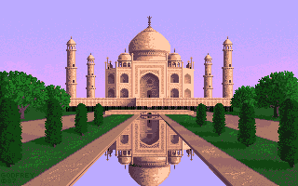
Shah Jahan
Taj Mahal
Built in honor of his wife who died during childbirth.
Took over a decade to build it and the empire nearly went bankrupt.
1657 - Shah Jahan became seriously ill and a dispute over the succession of the throne ensued between his three sons.
Aurangzeb deposed Shah Jahan in a coup in 1658. Shah Jahan was imprisoned in the Octagonal Tower of the Agra Fort from which he could see the Taj Mahal. He died in 1666 and was buried next to his wife in the Taj Mahal.

