Slide 1
THE ROMAN ARMY

Slide 2
Introduction
The spread of the Roman Empire was partly due to the fact that the Roman army was so well organised.
At the time of its invasion of Britain, the Roman army was the most disciplined and efficient killing machine that the ancient world had ever known.
Its men were well-equipped and highly trained, and operated in strict formation on the battlefield.

Slide 3
Only men could be in the Roman Army.
Every Roman soldier was a Roman citizen. He had to be at least 20 years old. He was not supposed to get married while he was a soldier.
Most soldiers in the Roman Empire came from countries outside Italy. There were Roman soldiers from Africa, France, Germany, the Balkans, Spain and the Middle East.
Soldiers had to stay in the army for at least 25 years! Then they could retire, with a pension or a gift of land to farm. Old soldiers often settled down to old age together, in a military town or colonia.

Slide 4
Structure of the Army
The Roman army was divided into legions of about 5,000 men.
Contubernium: consisted of 8 men.
Century: was made up of 10 Contubernium with a total of 80 men commanded by a centurion.
Cohorts: (cohort) included 6 centurie, a total of 480 men.
Legion: consisted of 10 cohorts, about 5,000 men.
Eques Legionis: Each legio had a cavarly unit of 120 attached to them.

Slide 5
A centurion commanded 80 men divided into ten sections of eight.
Six centuries of eighty men formed a cohort, and ten cohorts made up a legion (about 5,000).
There were over 5,000 soldiers in a legion.
Each legion had its own number, name, badge and fortress.
Tombstones at Chester indicate that some men joined the legions young; two men had been only fourteen when they had joined up.
A legion had commanders, officers and ordinary soldiers. There were also doctors, engineers and other workers

Slide 6
The legion was divided into ten cohorts
Each cohort was made up of six centuries
The centuries were commanded by a centurion
Centuries originally had 100 men

Slide 7
The centurions were very important men
They were responsible for training the soldiers under their command and making sure everyone obeyed orders.
Some were very cruel

Slide 8
The Roman Soldier
Roman soldiers were very strong and tough, they had to march over 20 miles a day with heavy things to carry.
They had to carry equipment such as tents, food, cooking pots and weapons as well as wearing all their armour.

Slide 9
Legionaries and Auxiliaries
The Roman army was divided into two groups - legionaries and auxiliaries.
The Roman legionary was a soldier who was a Roman citizen younger than 45.
The legionaires of the Roman army were recruited only from those who had Roman citizenship. By the first century, many inhabitants of Italy, Spain and Gaul (France) were Roman citizens and were eligible to serve.
Legionaires served in the army for 20 years. They were well-armed and well trained fighting men.
They were also skilled engineers and craftsmen because they had to build roads, bridges and forts.

Slide 10
Auxiliaries
An auxiliary was a soldier who was not a Roman citizen.
He was paid a third as much as a legionary.
Auxiliaries guarded forts and frontiers, but also fought in battles, often in the front lines, where it was the most dangerous.
They were recruited from tribes that had been conquered by Rome or were allied to Rome.
Roman Auxiliaries had to serve for 25 years, after which they became Roman citizens.

Slide 11
Some soldiers had special skills.
They shot bows and arrows, flung stones from slingshots, or could swim rivers to surprise an enemy - like modern commandos.
Artillery soldiers fired giant catapults, called onagers in Latin, machines that fired rocks or balls of burning tar.
The Romans used big wind-up crossbows, called ballistas in Latin, too.
Usually, Romans liked to fight on foot.
They used cavalry (soldiers riding horses) to chase a fleeing enemy. In a battle, the cavalry often lined up either side of the infantry (foot-soldiers).

Slide 12
Training
18-20 years old
There were three 30km marches each month
On each march the legionary would carry 25 kilos of equipment
Legionaries would also learn drill, or marching
This was important for learning manoeuvres in battle

Slide 13
Equipment of a Roman Soldier
Cassis - helmet
Lorica Segmentata - armour
Focale and cingulum - scarf and tunic worn under armour
Gladius - sword, 18-24 in. long
Pilum (plural pila) - medium-length throwing spear
Scutum - shield
Red Battle Cloak
Caligae or military boots

Slide 14
A Roman soldier wore armour made from strips of iron and leather (lorica segmentata in Latin).
On his head was a metal helmet (galea).
He carried a rectangular shield (scutum), curved so it protected his body.
The shield was made of wood and leather.

Slide 15
The soldier's main weapons were a short sword for stabbing (gladius) and a long spear, or javelin (pilum) for throwing.
The javelin had a sharp iron point, and a thin, bendy shaft.
When it hit an enemy's shield, the point stuck in, but the shaft bent. This made it difficult to pull out. The long spear shaft got in the way, so the enemy soldier had to throw away his shield.

Slide 16
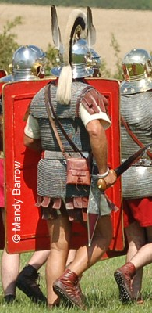
Scutum and Gladius

Slide 17
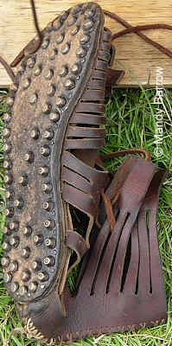
Caligae (sandals)

Slide 18
Soldiers moved from one place to another by marching.
Life for soldiers on the move was very hard. At the end of a day's march they had to build a camp.
Each soldier carried a his kit (equipment) on a pole.
He had spare clothes, food rations, a cooking pot, a short spade, a hand mill for grinding corn and two wooden stakes to help build a protective fence (palisade).

Slide 19
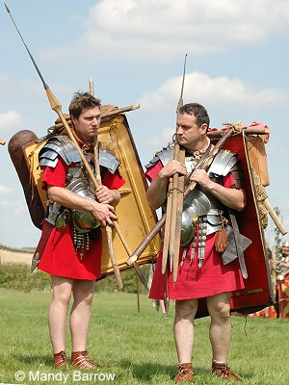
A Roman Soldier’s Kit

Slide 20
Roman Officers
The Legate was the leader of a Legion.
Most centurions were in charge of a 'century' (centuria) a group of eighty men, but senior centurions commanded cohorts, or took senior staff roles in their legion.
A centurion was easily spotted by:
the sideways horse hair crest on his helmet
a shirt of mail armour over a leather arming-doublet
a cloak of fine material
medals on his chest, awarded for bravery in battle
sword on the left and his dagger on the right

Slide 21
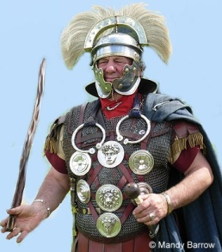
A Centurion

Slide 22
To show the differences in ranks centurions carried a special stick to show who they were
They used the stick to beat any soldier who disobeyed an order.

Slide 23
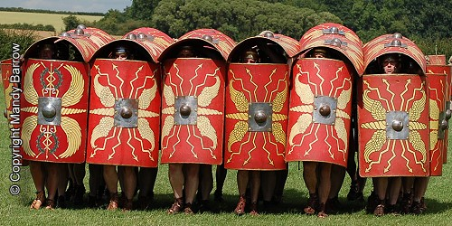
Roman Army – Tortoise Formation

Slide 24
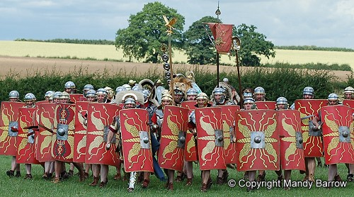
Roman Army –Wedge Formation

Slide 25
The Wedge
The wedge was used to 'crack open' enemy lines. Legionaries formed up in a triangle, the front 'tip' being one man and charged towards enemy lines with their gladius out.

Slide 26
The Tortoise (Testudo)
One of the Romans most famous formations was the Tortoise (Testudo). Testudo is the Latin word for "tortoise".
The soldiers in front and sides interlocked their shields. The soldiers in the back lines placed their shields over their heads to form a protective "shell" over top of the men.
The Testudo was a very strong, tight formation. It was usually used to approach fortifications. The soldiers could march up to a fort in the Testudo formation and not one of them would get hurt.
The shields fitted so closely together that they formed one unbroken surface without any gaps between them. It has been said that it was so strong a formation that men could walk upon them, and even horses and chariots be driven over them.

Slide 27
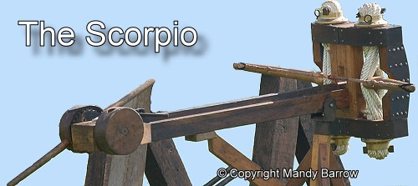
DART THROWER

Slide 28
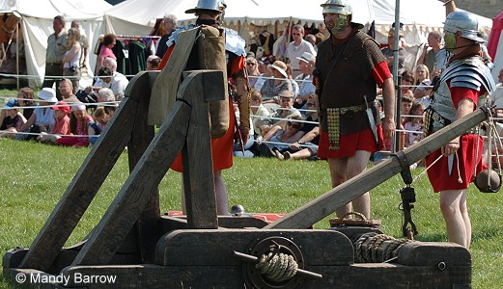
CATAPULT- OLANGER

Slide 29
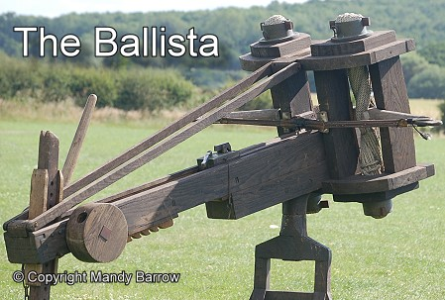
GIANT CROSSBOW

