Slide 1
WHY WAS THE MEDIEVAL CHURCH SO IMPORTANT?
Grade 7

Slide 2
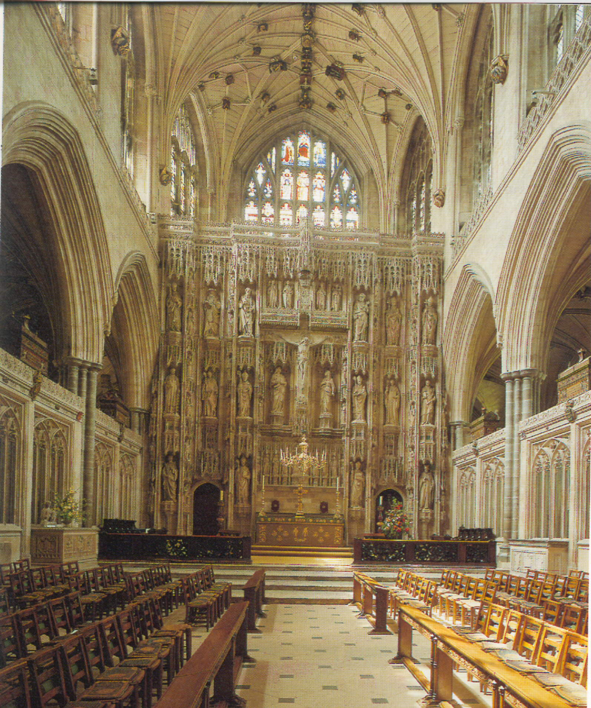
A Cathedral at Winchester

